Slide 1


Title: Beyond Access: State SRD Digital Systems Illegibility among Women Informal Workers
Presented by: Shirin Motala
Co-Authors: Dr Stewart Ngandu & Dr Bongiwe Mncwango
Date: 16 September 2026

Slide 2
Theorising the structural barriers that keep women in the informal sector outside state digital systems in South Africa

Slide 3
Context: South Africa’s Covid 19 response for vulnerable workers in the economy
30%+
Official unemployment rate; expanded definition exceeds 40%
R350
Monthly SRD grant
Bbelow the food poverty line (R624)
24%
Women using the internet in Africa vs 35% of men
2.4 M
Women in the informal sector in South Africa
The SRD Grant — A Digital Stress Test
Launched April 2020 as emergency COVID-19 relief. Digital-only application via WhatsApp or USSD. Required individual ID number, registered mobile, and bank account — prerequisites that excluded the most precarious workers.
Motala et al., 2026 | ITU, 2021 | Wills et al., 2021 | Stats SA, 2024

Slide 4
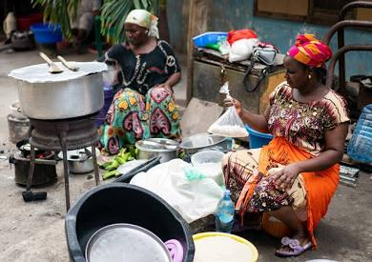
2.7 Million SRD Rejections in one quarter

Slide 5
Methodology: A Theory-Led Secondary Analysis, grounded in informal sector women’s experiences
1
Theoretical frameworks
Fraser's four Dimensions of Justice, redistribution, recognition, representation and misframing, combined with Scott's "Seeing Like a State" legibility theory, frame how the state (mis)sees informal-sector workers.
2
Research design
A secondary analysis study: interpreting existing evidence through the justice-and-legibility lens rather than generating new survey data.
3
Primary source for women’s lived experiences: Bellville case study (Bob, Motala et al)
Draws primarily on a qualitative case study of informal-sector workers at the Bellville transport interchange, Cape Town: 36 in-depth interviews with street traders, food vendors and waste pickers during the 2020 COVID-19 lockdown. Included both genders and documented and undocumented traders
4
Supplementary data
Complemented by NIDS-CRAM survey findings and other published sources on informal employment, income shocks and SRD access during COVID-19.
Motala et al., 2026

Slide 6
The SRD C19 System was Never designed for Women in the Informal Sector: Exposing the scale of Exclusion
During South Africa's COVID-19 crisis, the state deployed a digital social relief system (Social Relief of Distress grant) to reach the most vulnerable.
For 2.7 million applicants, the system said NO — not because they were ineligible, but because they were unreadable.
Women in the informal economy met the criteria, had access to a phone, the willingness to apply — but not the formal data trail the system demanded
The rejection was not a technical glitch — it was an outcome of a system built around a formal worker who does not exist for most South African women
2.7M
SRD grant applications declined in a single quarter
2.4M
Women workers in South Africa's informal economy
This paper asks: when the state cannot see someone, what does it cost, who bears these costs and what redress systems are available?
Motala et al., 2026 | SASSA, 2022

Slide 7
The SRD Digital System was designed on assumptions of who were the vulnerable workers in the economy
The Assumed Worker
BANK ACCOUNT: Personal formal bank account registered in own name
PHONE IDENTITY: SIM card registered in own name, individual account
ADDRESS: Fixed physical address verifiable in state records
EMPLOYMENT STATUS: No formal payroll income — easily verified as unemployed
The Real Informal Worker
BANK ACCOUNT: Shared, family, or mobile-wallet accounts — cash earnings
PHONE IDENTITY: Often SIM registered to husband, parent, or borrowed from kin
ADDRESS: Informal settlement, shared dwelling, no formal street address
EMPLOYMENT STATUS: Intermittent cash earnings trigger false "employed" flags in bank data

Slide 8
Findings

Slide 9
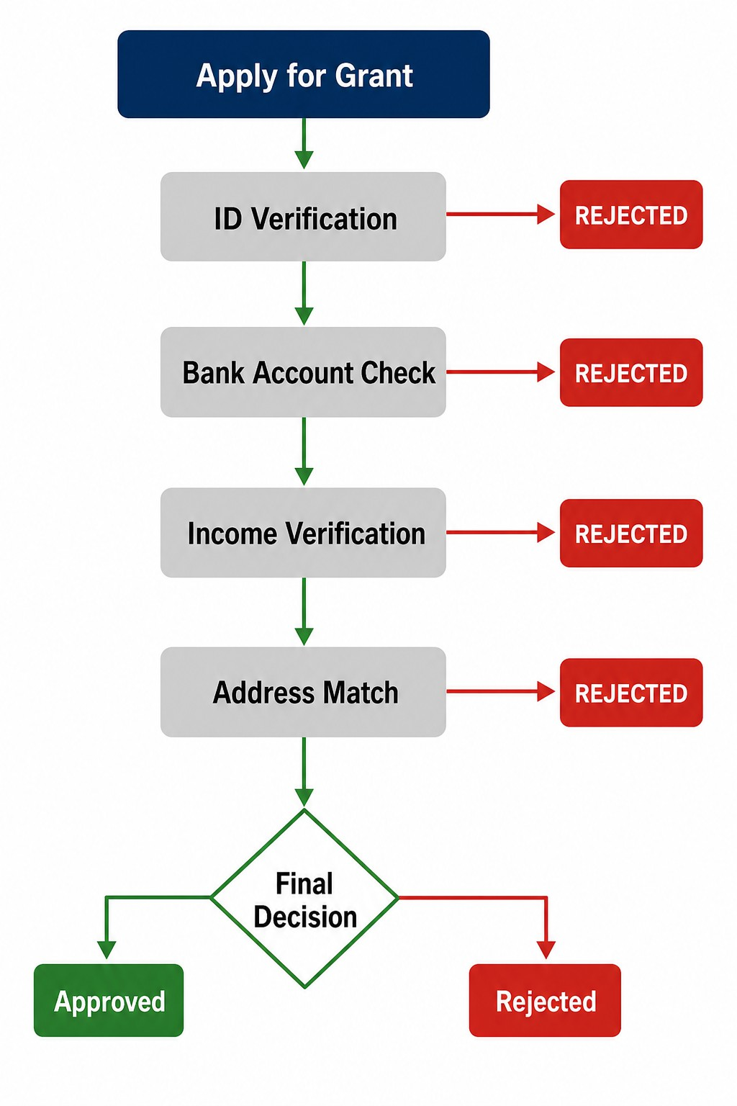
Having a Phone Is Not Enough — The System Demands a Formal Data Trail
FINDING 1
Our participants were digitally active — but digitally invisible to state eligibility systems
The SRD application imposed a "triple lock" that most women informal workers could not open:
Individual bank account, most women used shared or family accounts with irregular inflows flagged as "income"
Registered SIM card, devices and numbers shared across households, especially among migrant and domestic workers
Formal address, informal settlements and backyard rentals not recognised by verification databases
Cash-in-hand trading was unreadable; the only proof of informality was the absence of formal data, itself triggered rejection

Slide 10
Women Bear Double Labour: Paid Work Collapsed, Care Work Surged
FINDING 2
49%
Decrease in work hours for women in the informal economy
During hard lockdown — NIDS-CRAM Wave 1, 2021
“The money offered in exchange for recyclables is so low I am unable to work with my children, so leaving them with a caregiver is expensive because I have to provide transport for the caregiver.”
— Waste picker, participant interview
“I work two jobs to survive. During the day, I work as an informal food employee from 6am to 6pm, whilst after hours I work as a domestic worker.”
Care and domestic labour intensified simultaneously as formal support disappeared
“I had to bring my children to work, on the streets;
I missed days at work when a child was unwell”
Motala et al., 2026 | Wills et al., 2021

Slide 11
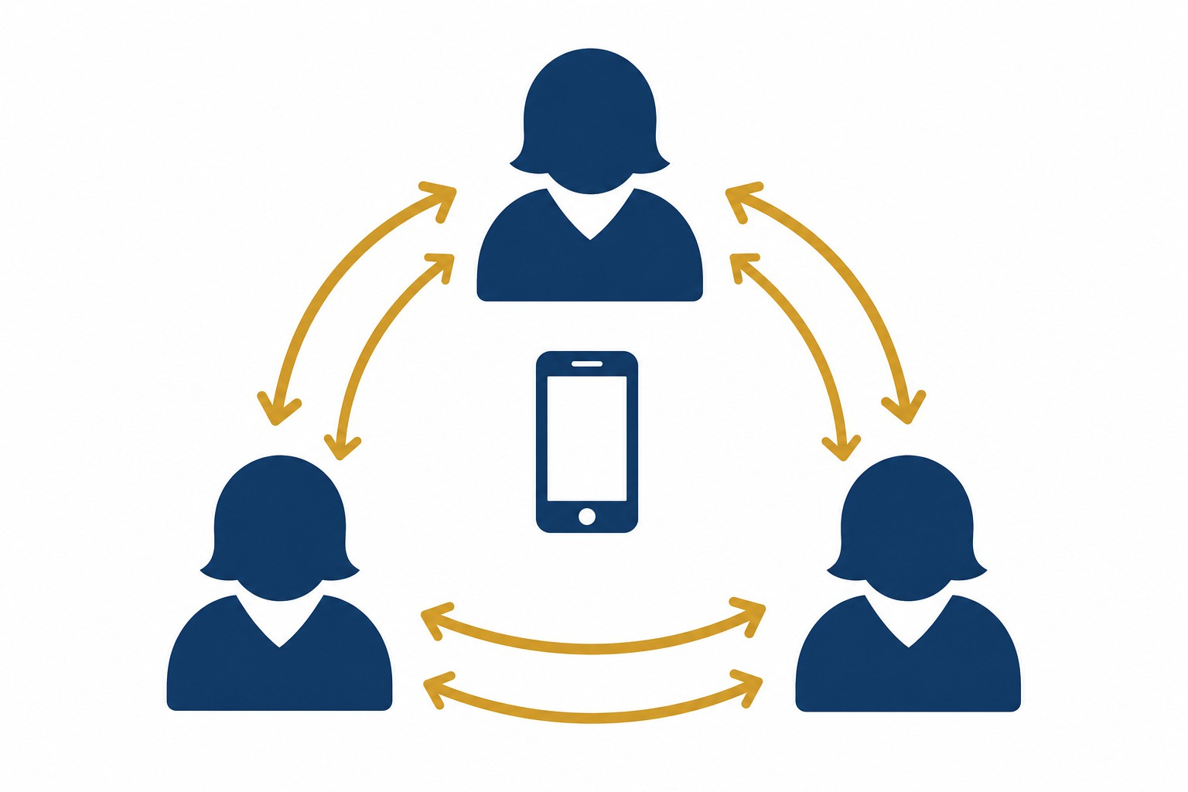
Exclusion Generates Its Own Economy — Women Navigated It Collectively
FINDING 3
Where the state withdrew, women built informal infrastructures of mutual aid to survive digitally.
WhatsApp networks: Real-time sharing of SASSA updates, appeal tips and workarounds across communities
Trusted intermediaries: Community members with devices and data became navigational anchors for others
Collective pooling: Sharing airtime, phones and application slots across households and neighbours
Peer-coached access: “She showed me how” — horizontal knowledge transfer replacing absent formal support
Informal Social Protection: Provided income support and food to workers
Motala et al., 2026

Slide 13
They Were Visible to the Market — Invisible to the State
The same participants who used social media fluently to advertise stock, coordinate suppliers and sustain sales were rejected by a system that required a formal bank account, a fixed address and an individual registered mobile number.”
 | Digital exclusion is not a capacity gap — it is a justice gap. The path forward demands not digital literacy for women, but state literacy about women's realities.
Motala et al., 2026

Slide 14
Four Propositions: Reframing Exclusion as Structural, Not Technical
1: Digital eligibility systems are coded for formality, they cannot read informality even when it is visible
2: Digital inclusion is relational, not individual, connectivity alone does not create legibility
EVIDENCE
Deposits as low as R50 triggered automatic rejection; 2.7 million SRD applications declined in a single quarter - system misread mutual aid as self-sufficiency (Khowa et al., 2026)
EVIDENCE
Bellville traders used social media fluently to advertise stock and coordinate suppliers, yet were rejected for lacking a personal bank account or fixed address (Bob et al., 2024)
3: Informality is structurally misrecognised — the state actively constructs illegibility through its own design choices
4: Digitalisation relocates rather than removes bureaucratic burdens — onto women's bodies and informal networks
EVIDENCE
Stokvel payouts and kin remittances were auto-coded as “alternative income”; automated means-testing misinterpreted survivalist solidarity as financial self-sufficiency (Khowa et al., 2026)
EVIDENCE
Queues and paperwork reappeared as repeated monthly re-verification, opaque rejections and inaccessible appeals; administrative burden was privatised onto the applicant (Faith et al., 2024)
Motala et al., 2026

Slide 15
Five Immediate Policy Changes That Would Make a Difference
1
Legislate a human backstop: no automated rejection without human review; guaranteed right of appeal. System remains fully automated; SASSA lacks capacity for physical assessment.
Court: automated bank & database verification ruled unlawful , databases carry a 33% error rate.
2
Zero-rate SRD application platforms on all mobile networks — data costs are a structural barrier. WhatsApp channel & some operators zero-rated, but not universal or guaranteed
Court: online-only application declared irrational, unlawful and exclusionary.
3
Fund community-based assisted-application points in every township and rural node. Existing kiosks questioned as inadequate at the SCA; process stays digital.
Court: in-person application must be allowed; online-only excludes rural, elderly and poor applicants.
4
Reform the means test: read net livelihood income, not gross account turnover. Account turnover still read as income
Court: bank verification as primary means test struck down; once-off payments and gifts are not income.
5
Guarantee intelligible rejection reasons and a real, plain-language appeals process. Appeals still echo the flawed verification; decline reasons remain opaque.
Court: the appeals rule barring reliance on new evidence declared unconstitutional.

Slide 16
References
Black Sash. (2023). Amandla ka bani? Power to whom? The shocking reality of digitalised social grant exclusions in South Africa. Black Sash Trust.
Bob, S. K., Motala, S., & Parkerson, C. (2024). From exclusion to inclusion: Extending parental protection to informal workers. In S. Motala, T. Hart, & S. Ngandu (Eds.), Social security review volume 2: Social security in the time of COVID-19 (pp. 41–61). Department of Social Development.
Daily Maverick. (2026, August 26). SRD grant battle reaches Supreme Court of Appeal as state challenges historic judgment.
Faith, B., Roberts, T., & Alfers, L. (Eds.). (2024). The digitalisation of social protection in Africa: The perspective of marginalised workers (IDS Research Report 90). Institute of Development Studies. https://doi.org/10.19088/IDS.2024.022
Fraser, N. (2005). Reframing justice in a globalizing world. New Left Review, 36, 69–88.
GroundUp. (2026, August). Expanding the SRD grant could cost R139-billion a year, National Treasury says.
Institute for Economic Justice & #PayTheGrants v Minister of Social Development, SASSA & Minister of Finance, Gauteng Division of the High Court, Pretoria (Twala J) (2025, January 24).
Rogan, M. (2020). The COVID-19 crisis and the South African informal economy: “Locked out” of livelihoods and employment (NIDS-CRAM Policy Paper No. 7).
Scott, J. C. (1998). Seeing like a state: How certain schemes to improve the human condition have failed. Yale University Press.
Socio-Economic Rights Institute of South Africa. (n.d.). IEJ & #PayTheGrants v Minister for Social Development: Case page and court papers. https://seri-sa.org
South African Revenue Service. (2025). Institute for Economic Justice & #PayTheGrants v Minister of Social Development, SASSA & Minister of Finance [High Court judgment].
South African Social Security Agency. (2025). Institute for Economic Justice & #PayTheGrants v Minister of Social Development, SASSA & Minister of Finance [High Court judgment].
Sowetan. (2026, August 25). Explainer: Why government is challenging ruling on “exclusionary” SRD grant.

Slide 17
Thank you

