Slide 1





Presenter: Carla Osthoff Date: Sept 16th
TOPIC: Brazil’s Scientific Computing Sector Between Sovereignty and Dependency: Infrastructure, Brain Drain, and the AI Plan (PBIA) `

Slide 2

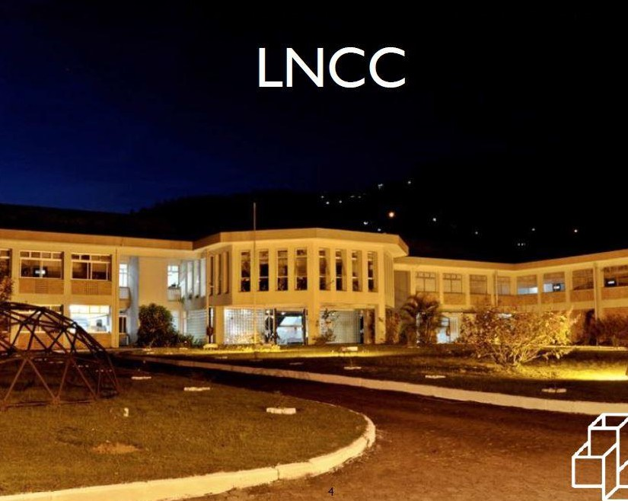
National Laboratory for Scientific Computing Ministry of Science Technology and Innovation
Petrópolis-Rio de Janeiro

Slide 3
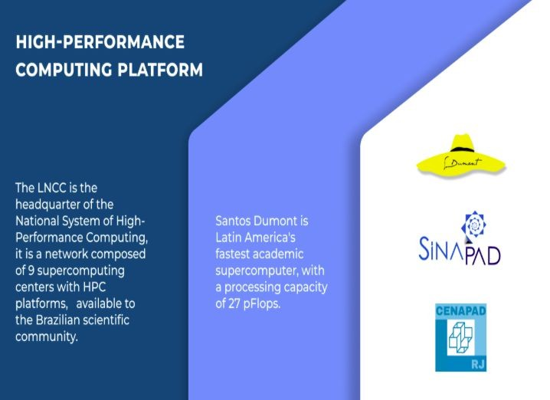
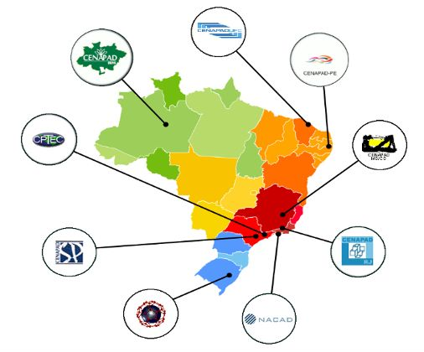

Slide 4


Slide 5
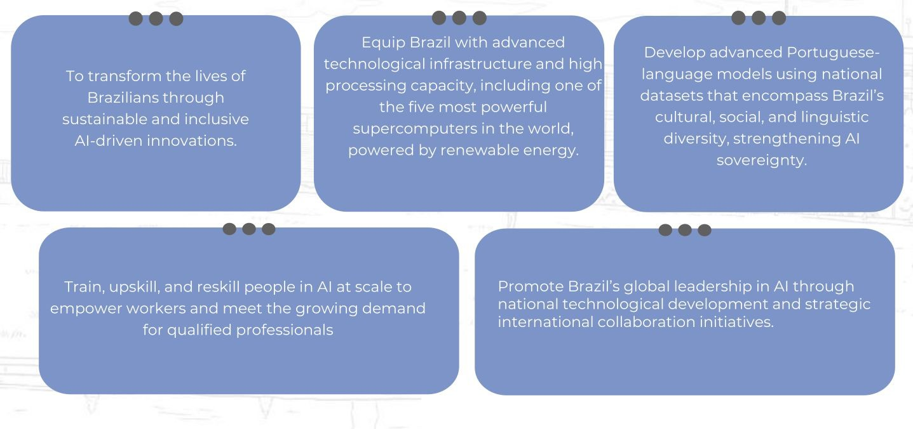
The AI for good of all plan aims to

Slide 6
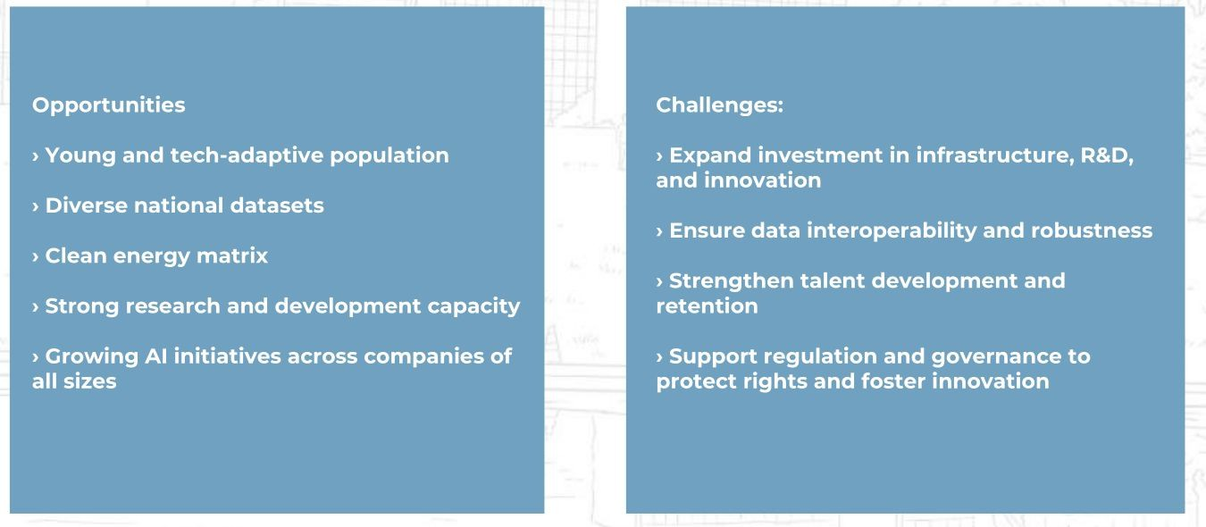
Artificial Intelligence is a field of research with tools capable of driving Brazil’s social and economic development

Slide 7
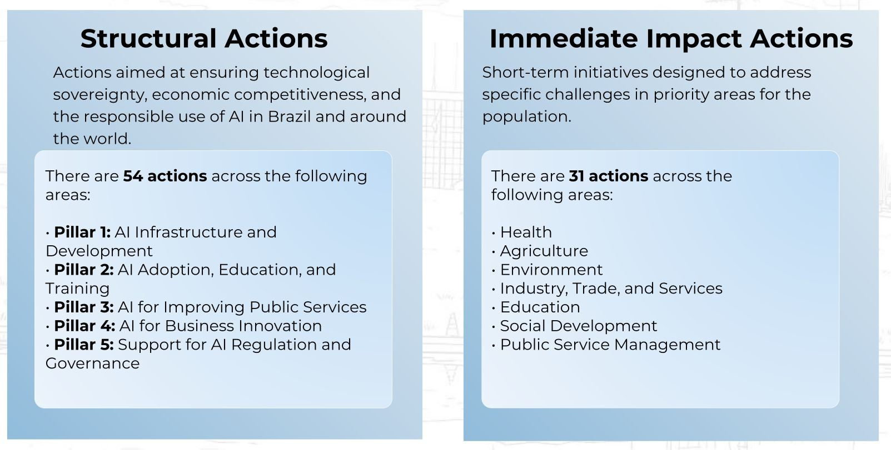
ACTIONS

Slide 8
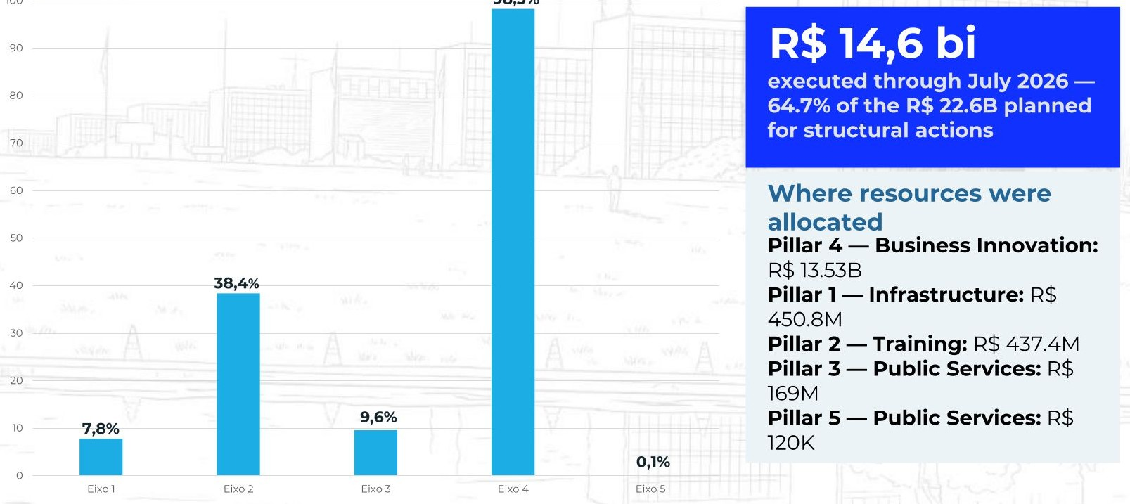
Budget execution by pillar through 2026

Slide 9
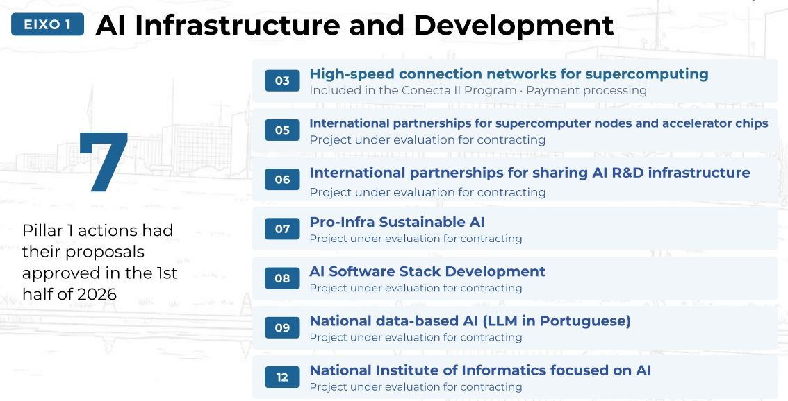

Slide 10
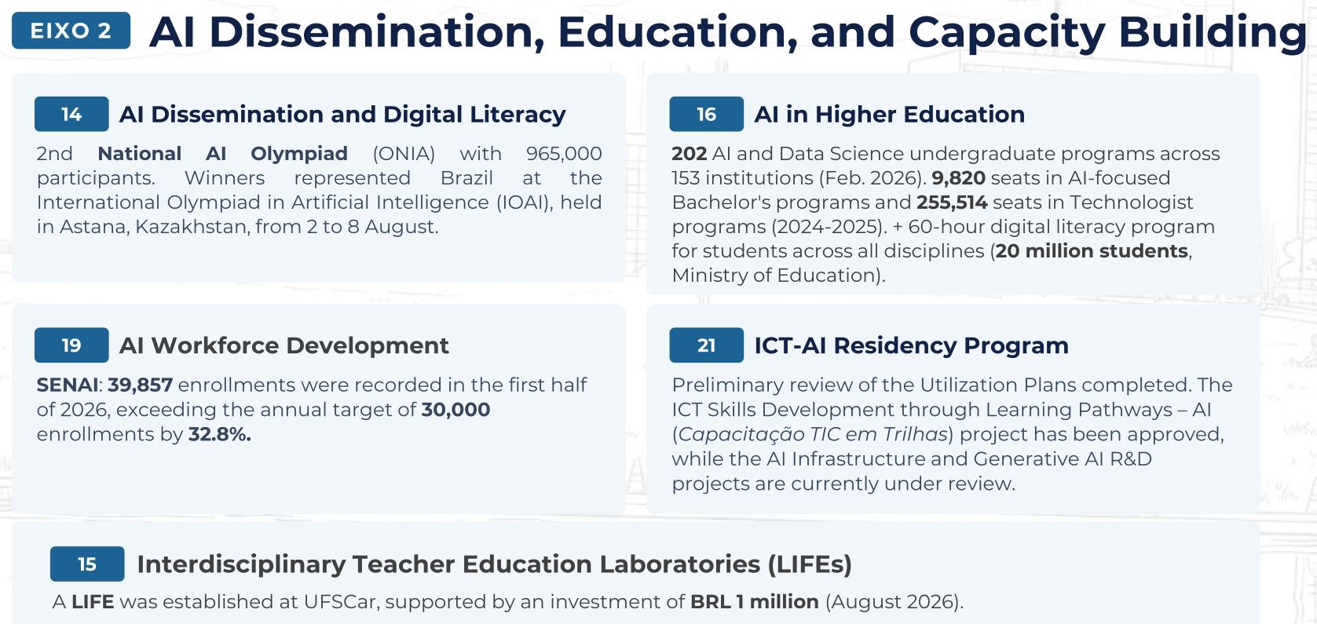

Slide 11
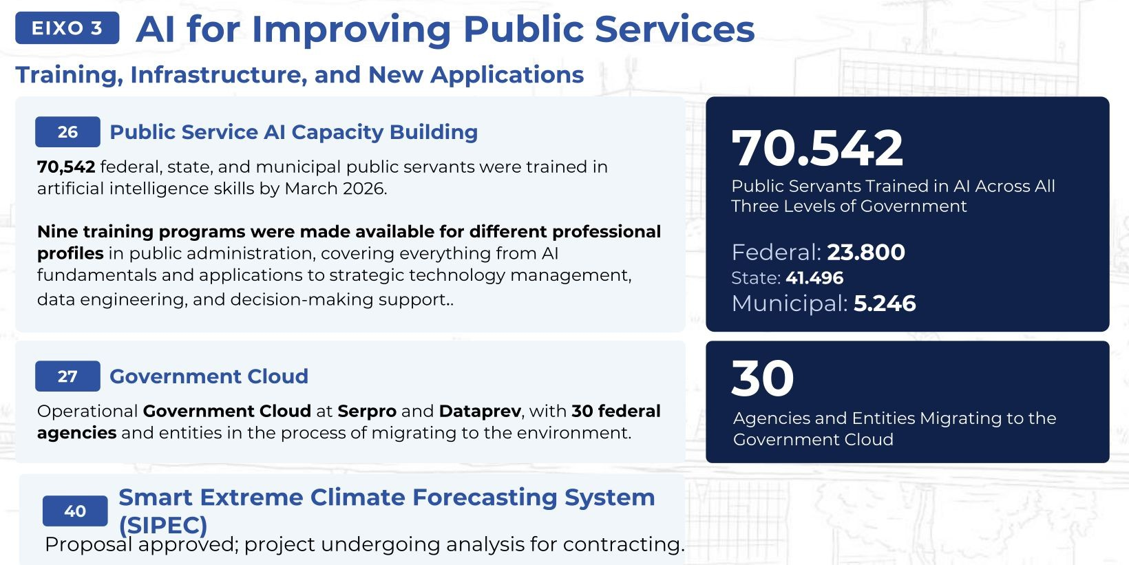

Slide 12
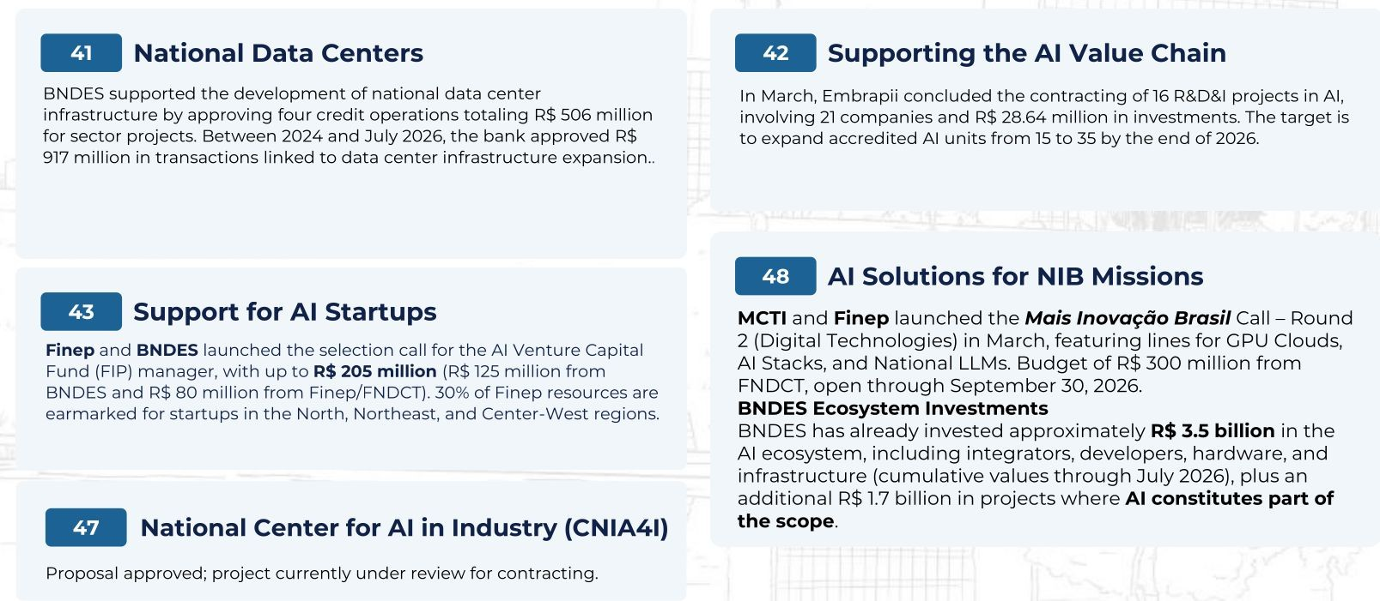
EIXO 4- AI for Enterprise Innovation

Slide 13
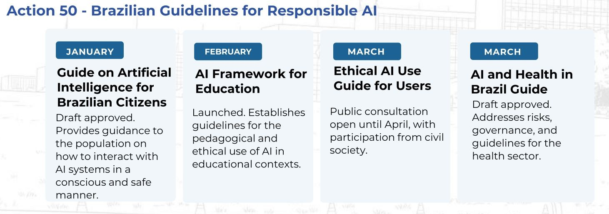
EIXO 5- Support for AI Regulation and Governance

Slide 14
EIXO 5- Support for AI Regulation and Governance

Slide 15
EIXO 5- Support for AI Regulation and Governance

Slide 16

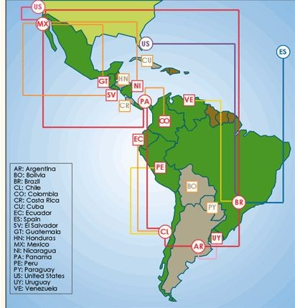
EIXO 6- International partnerships for sharing AI R&D infrastructure - https://scalac.redclara.net/en/

Slide 17



Slide 18
Thank you
Carla Osthoff
osthoff@lncc.br

