Slide 1



Innovating public participation in the City of Johannesburg
Kureish Isaacs
15 Sept 2026

Slide 2

Innovating Public Participation
In the City of Johannesburg
How can data, technology and AI help local government become more responsive, accountable and effective?
OUR MAIN QUESTION
Notes:
How can data, technology and AI help local government become more responsive, accountable and effective?

Slide 3

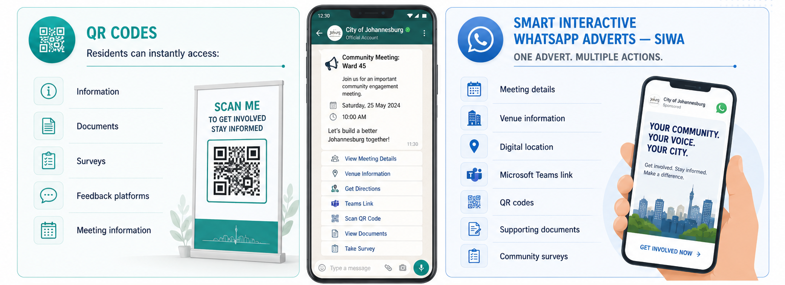

Reimagining Public Participation
From Fragmented Communication to Smart Engagement

Slide 4
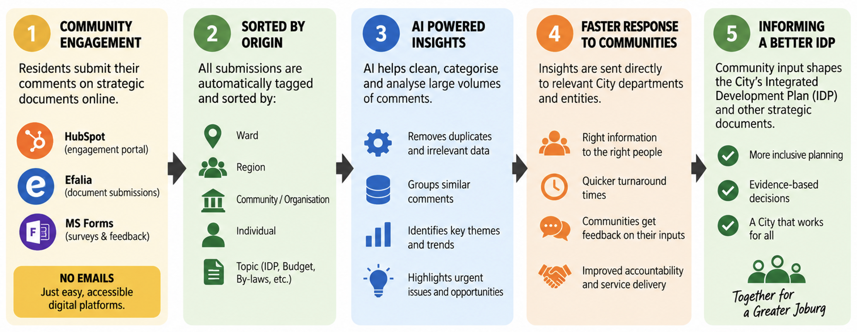
Community-Based Planning and IDP
For a More Connected Joburg

Slide 5
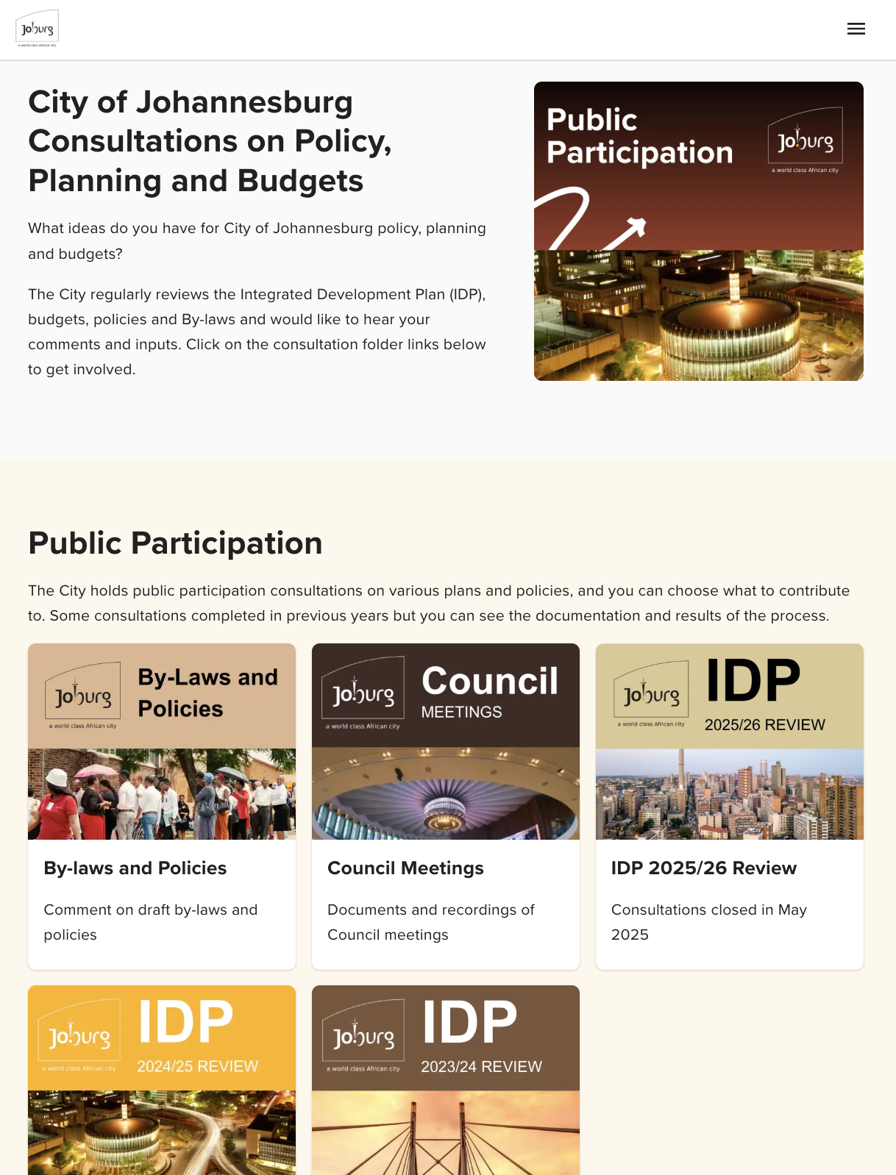
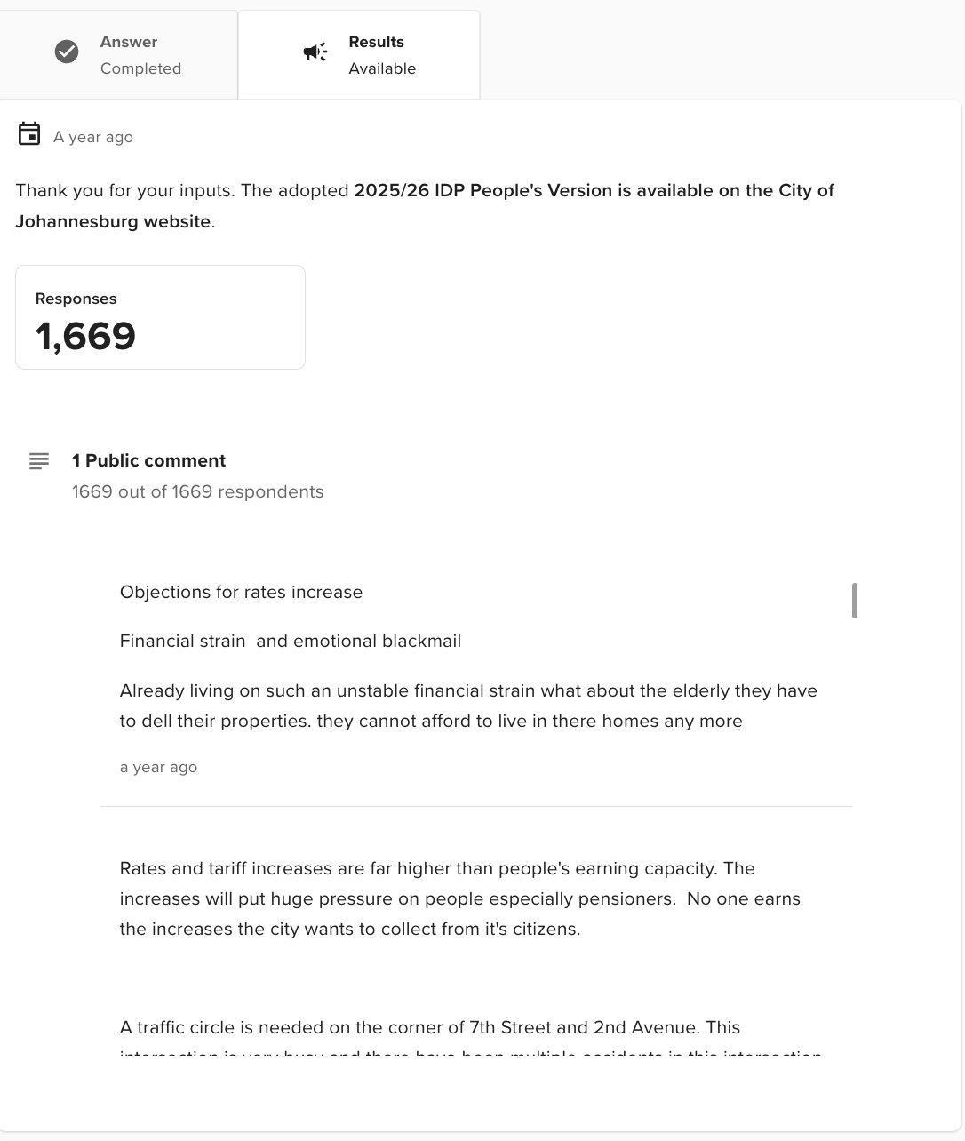
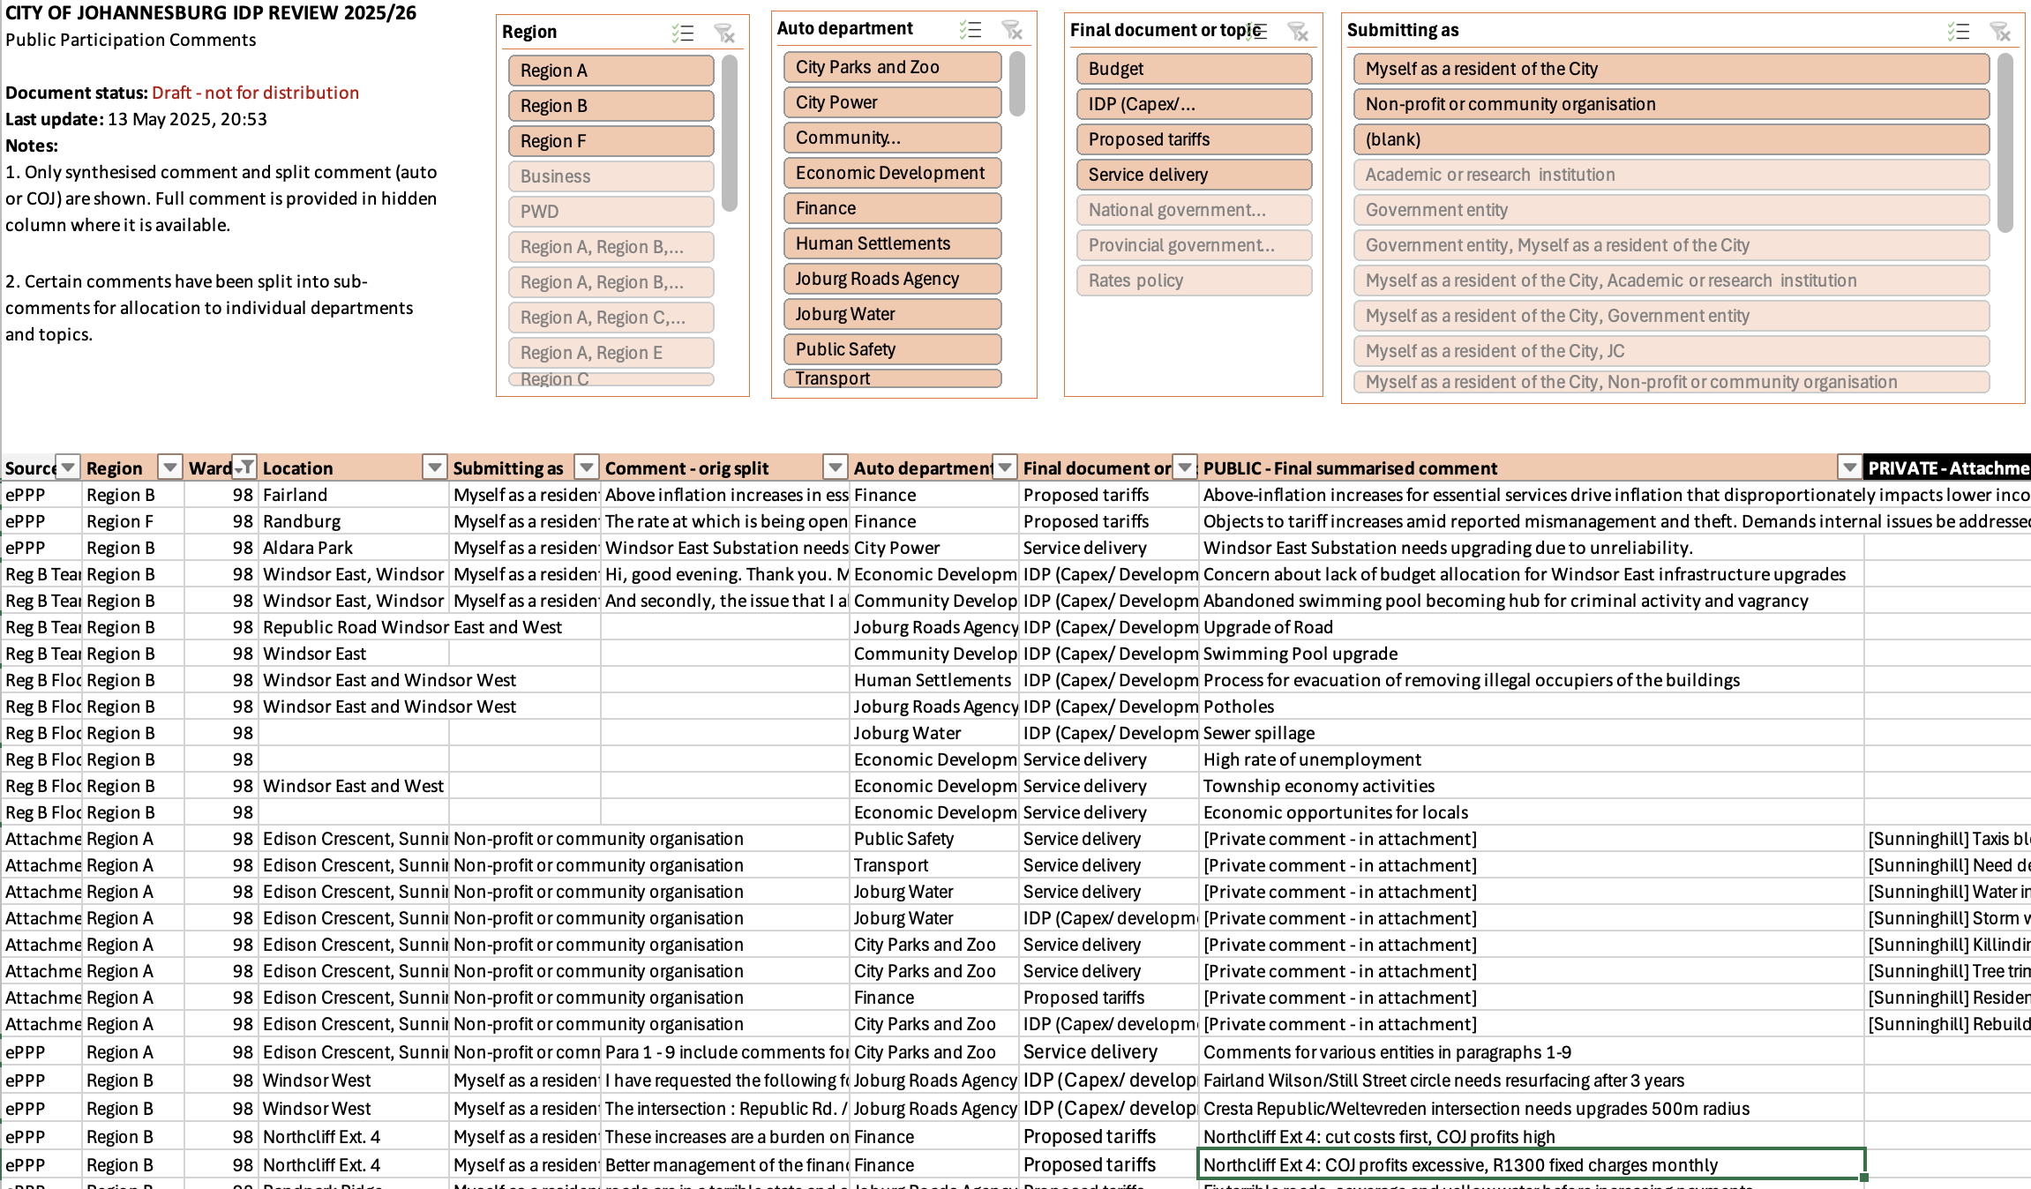
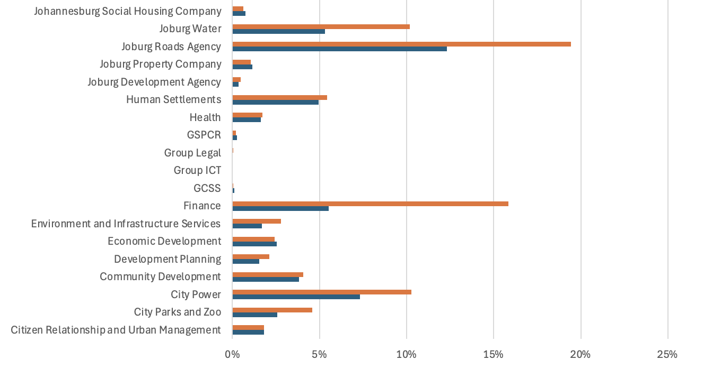
From Comments to Action
Piloting Public Participation Management Platform and AI-Assisted Analysis and Action

Slide 6
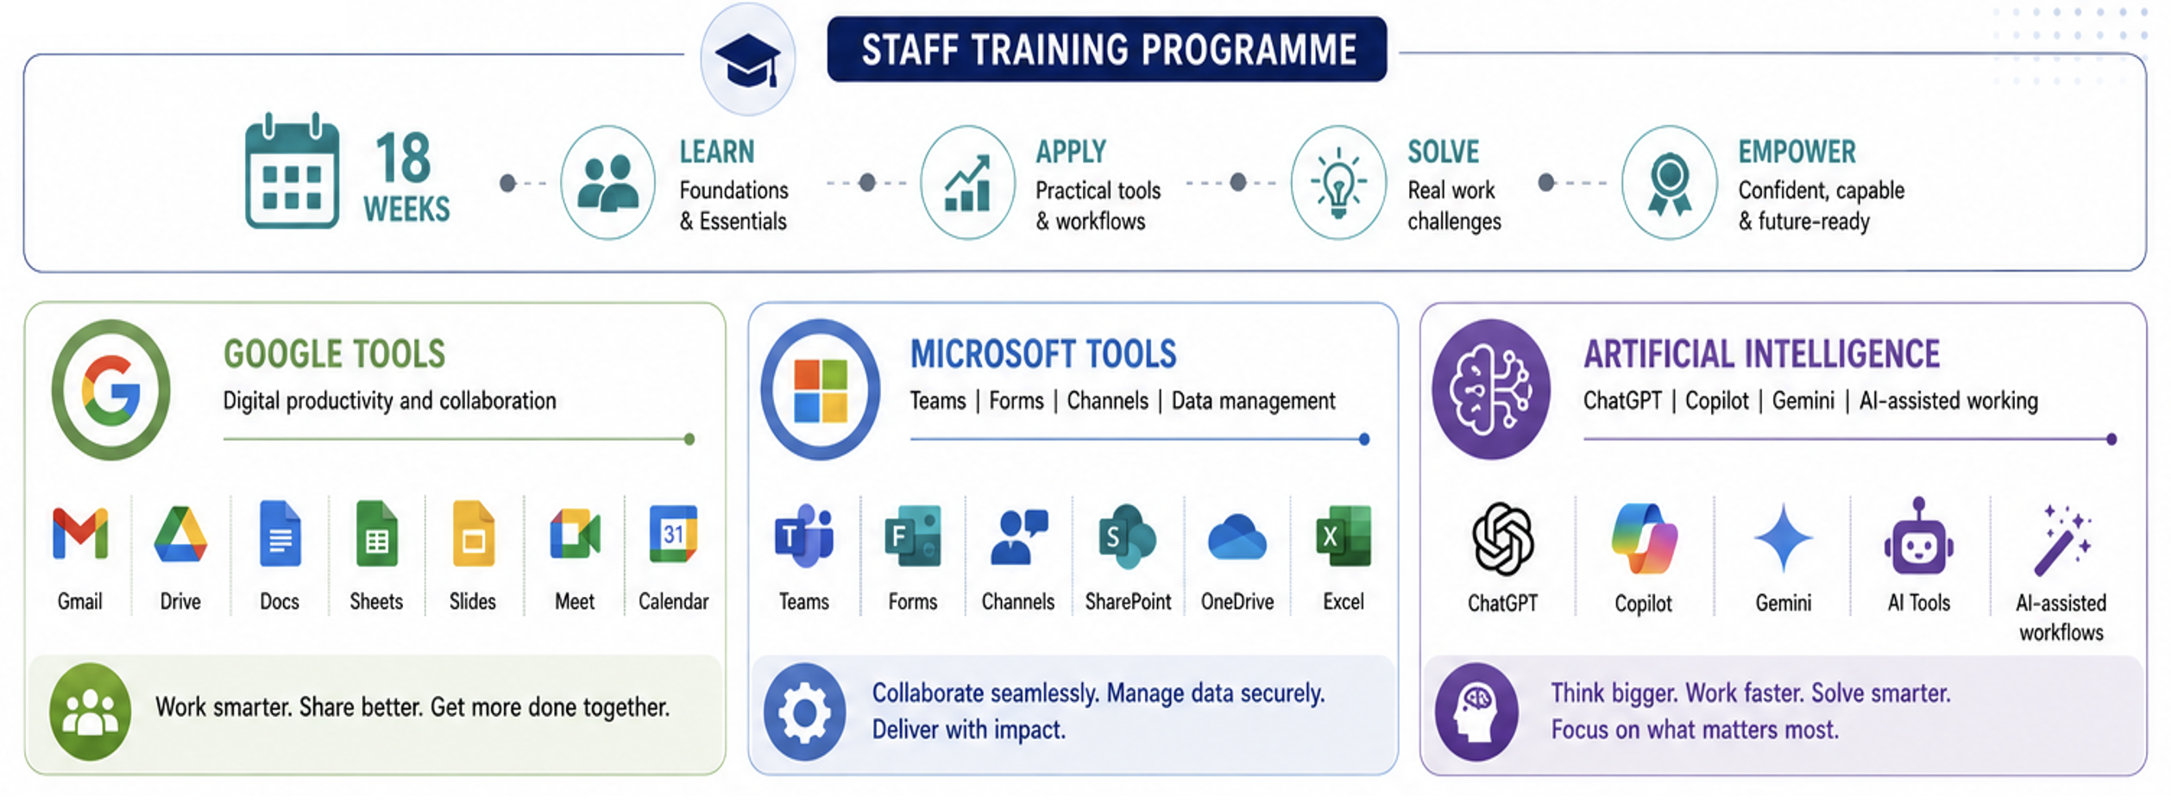
Our Biggest Investment: Our People
18 Weeks of Digital and AI Capability Development

Slide 7
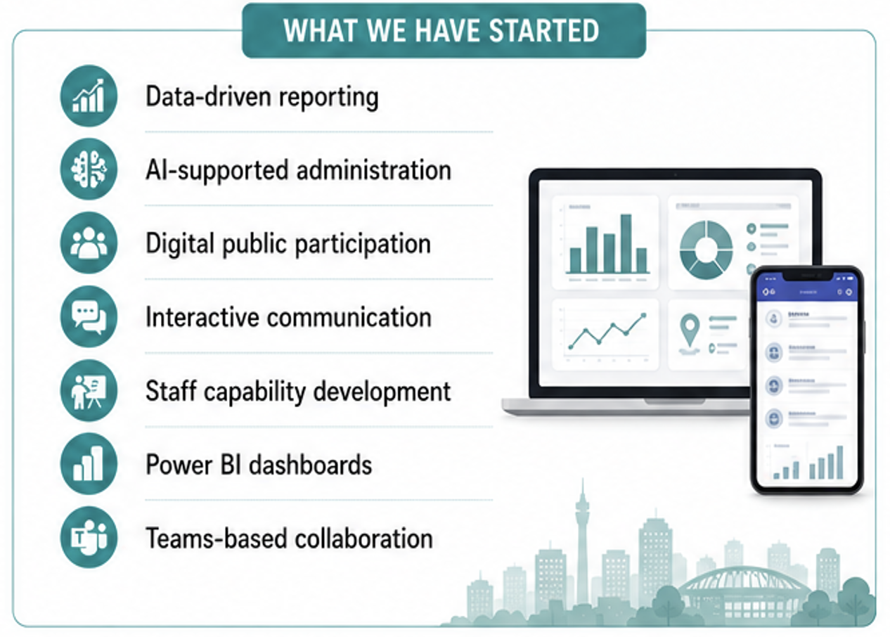
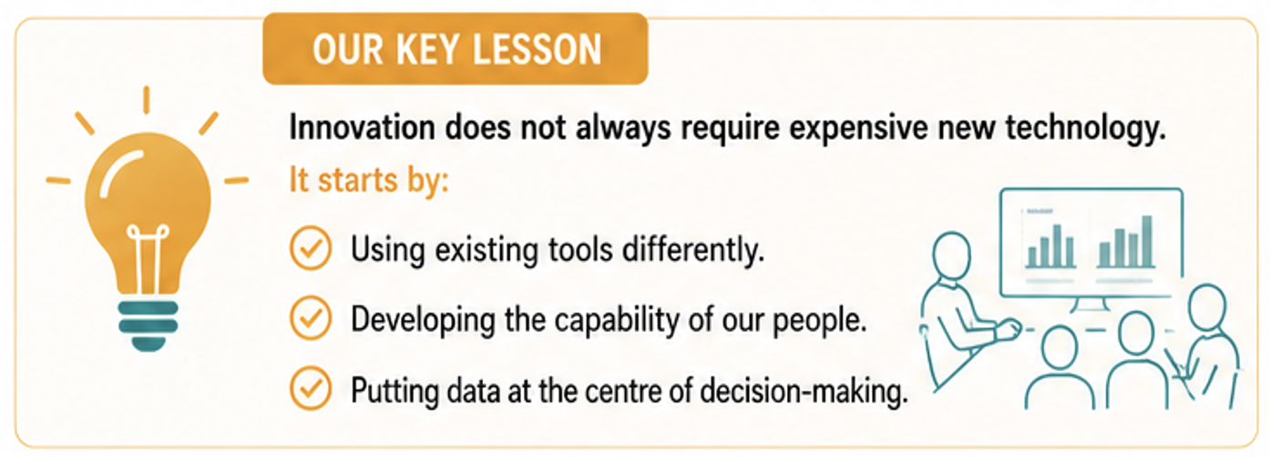
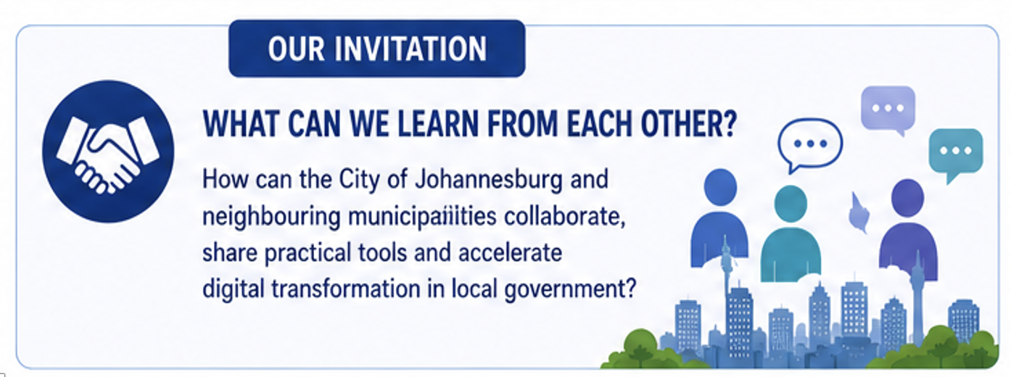
Key Lessons and Invitation
From Digital to Intelligent Local Government

Slide 8
Thank you

