Slide 1
Presenter: Dr Tsosheletso Chidi
Date: 16 September 2026
Topic: Digital Inequality and Social Justice

Slide 2

Digitality in Context

Slide 3

Digital Inequality and Social Justice: Relational Dynamics
The conversation we cannot avoid:
Whether we call it digitality or artificial intelligence,
the conundrum is already in our midst. We must have the conversation about whose knowledge, whose interests, and whose humanity shape the digital future.
Digital Divide
Digital Inequality
Social Justice

Slide 4

When Digital Inequality Becomes Social Inequality
“Today every aspect of human life is fueled by data” (Smith & Browne, 2019)
Digitality is changing how knowledge is:
produced, stored, accessed, shared , and used.
But this raises a fundamental question:
Whose knowledge becomes digital?
And therefore:
Who is represented in the knowledge systems that shape our lives?
This is where digital equality becomes a question of knowledge, representation, and power.

Slide 5
Digital Justice and Epistemic Agency
If the Global South is to achieve digital justice, it cannot only consume digital technologies. It must participate in producing the knowledge systems that shape them. This requires:
Africa is not simply a site of technological need, but that of alternative ways of understanding intelligence.
Digital justice requires epistemic justice: the right of communities to participate in determining how their knowledge is produced, represented and used.
Representation
Participation
Ownership
Agency
Knowledge production

Slide 6
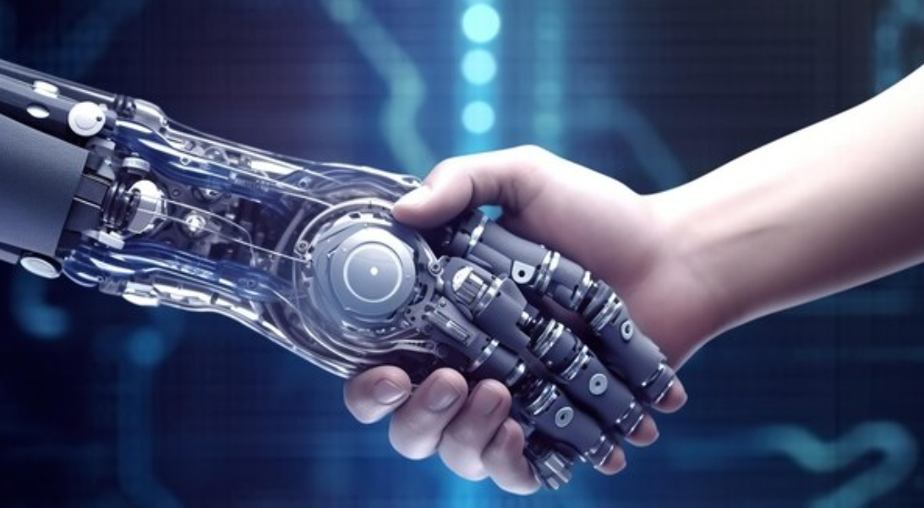
Technology, Power and Humanity
“The more powerful the tool, the greater the benefit or damage it can cause” (Smith & Browne, 2019)
Digital transformation holds enormous promise.
But technology can also become a mechanism through which inequalities are reproduced, economic systems disrupted and social power concentrated.
Are we creating a world we can even control?
What must we refuse, rewrite or re-wire?
The fundamental contradiction:
Digitality promises human advancement, yet can simultaneously perpetuate inequalities and threaten social justice.
Therefore, technological progress cannot be separated from ethics, social responsibility and human purpose.

Slide 7
The role of the humanities and social sciences is to keep digital transformation in service of humanity. Digital justice requires national coordination, public policy, research, education and sustained engagement with its social consequences. If digitality is becoming a common denominator of society, who gets to decide what kind of society it will produce?
The future of digital society will not be determined by technology alone, but by whose knowledge, whose intelligence and whose humanity we place at its centre.

Slide 8
"Re llela go phela"
"Re lliša ke go phela"
(Matsepe,1983)
We strive to live.
Life make us weep.
Thank you! Re a leboga! Mošate!

