Slide 1



e-Participation Pilot Project in Mogale City Local Municipality
Tshepo Legodi & Sanah Madikwe-Twala
15 Sept 2026

Slide 2
How Mogale City Engaged Before
The traditional engagement model, and what it lacked
Engagement depended on being in the room. Information travelled outward, but the community had no digital route to respond.
HOW IT WORKED
WHAT IT LACKED
IDP consultation in physical meetings only
No platform for online engagement
Residents had to attend in person to be heard.
Documents shared online and in newspapers
No real-time or structured feedback
Published on the website and in the press for information.
Limited reach beyond those who could attend
One-way flow of communication
Communities were informed, not engaged in dialogue.
No digital record linking voice to decisions

Slide 3
Moving Towards Integrated Participation Cycle
How community voice becomes municipal action
Engage
1. Engage
Ward and community meetings supported by online channels. Also drawing on Asset-Based Community Development (ABCD) methods
4. Report back
Decisions and progress are communicated openly, strengthening accountability.
Report back
Capture
Continuous feedback cycle
2. Capture
Community priorities and concerns are recorded and tracked.
Integrate
3. Integrate
Inputs are linked to the IDP, Budget and service-delivery planning.

Slide 4
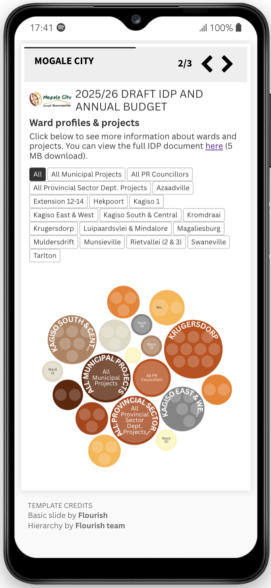
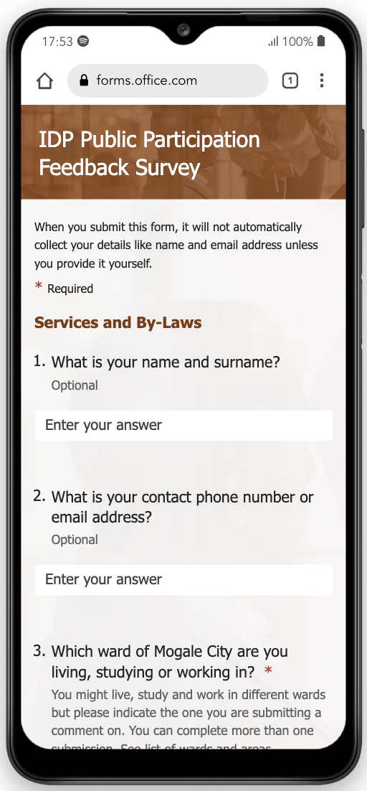
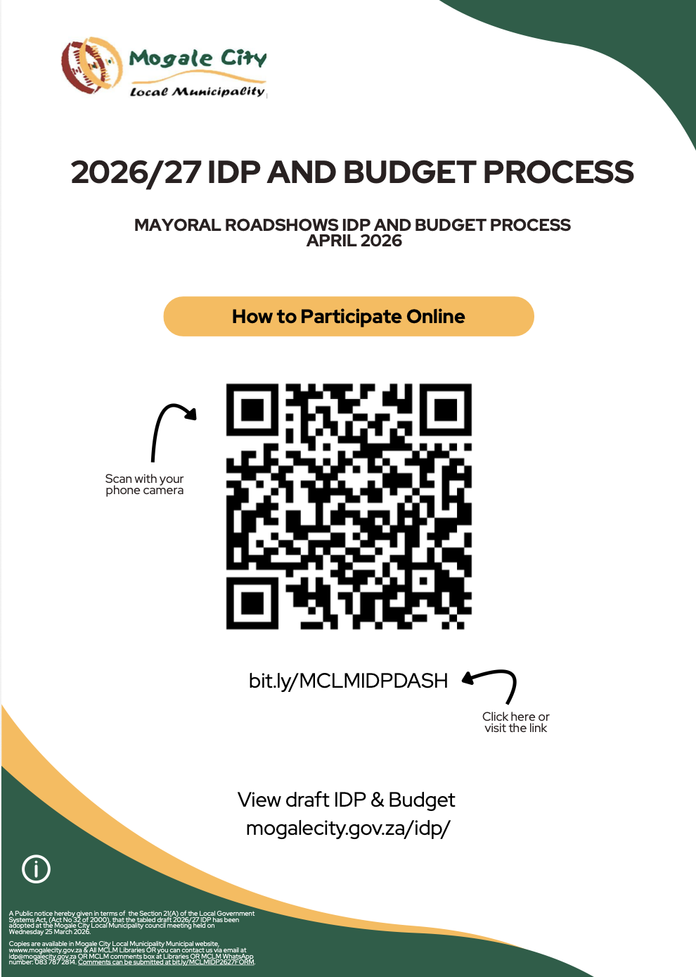
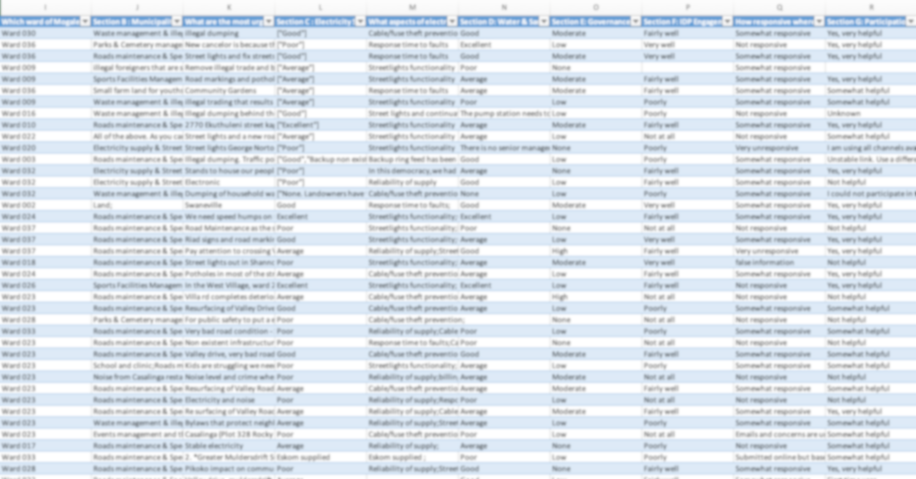
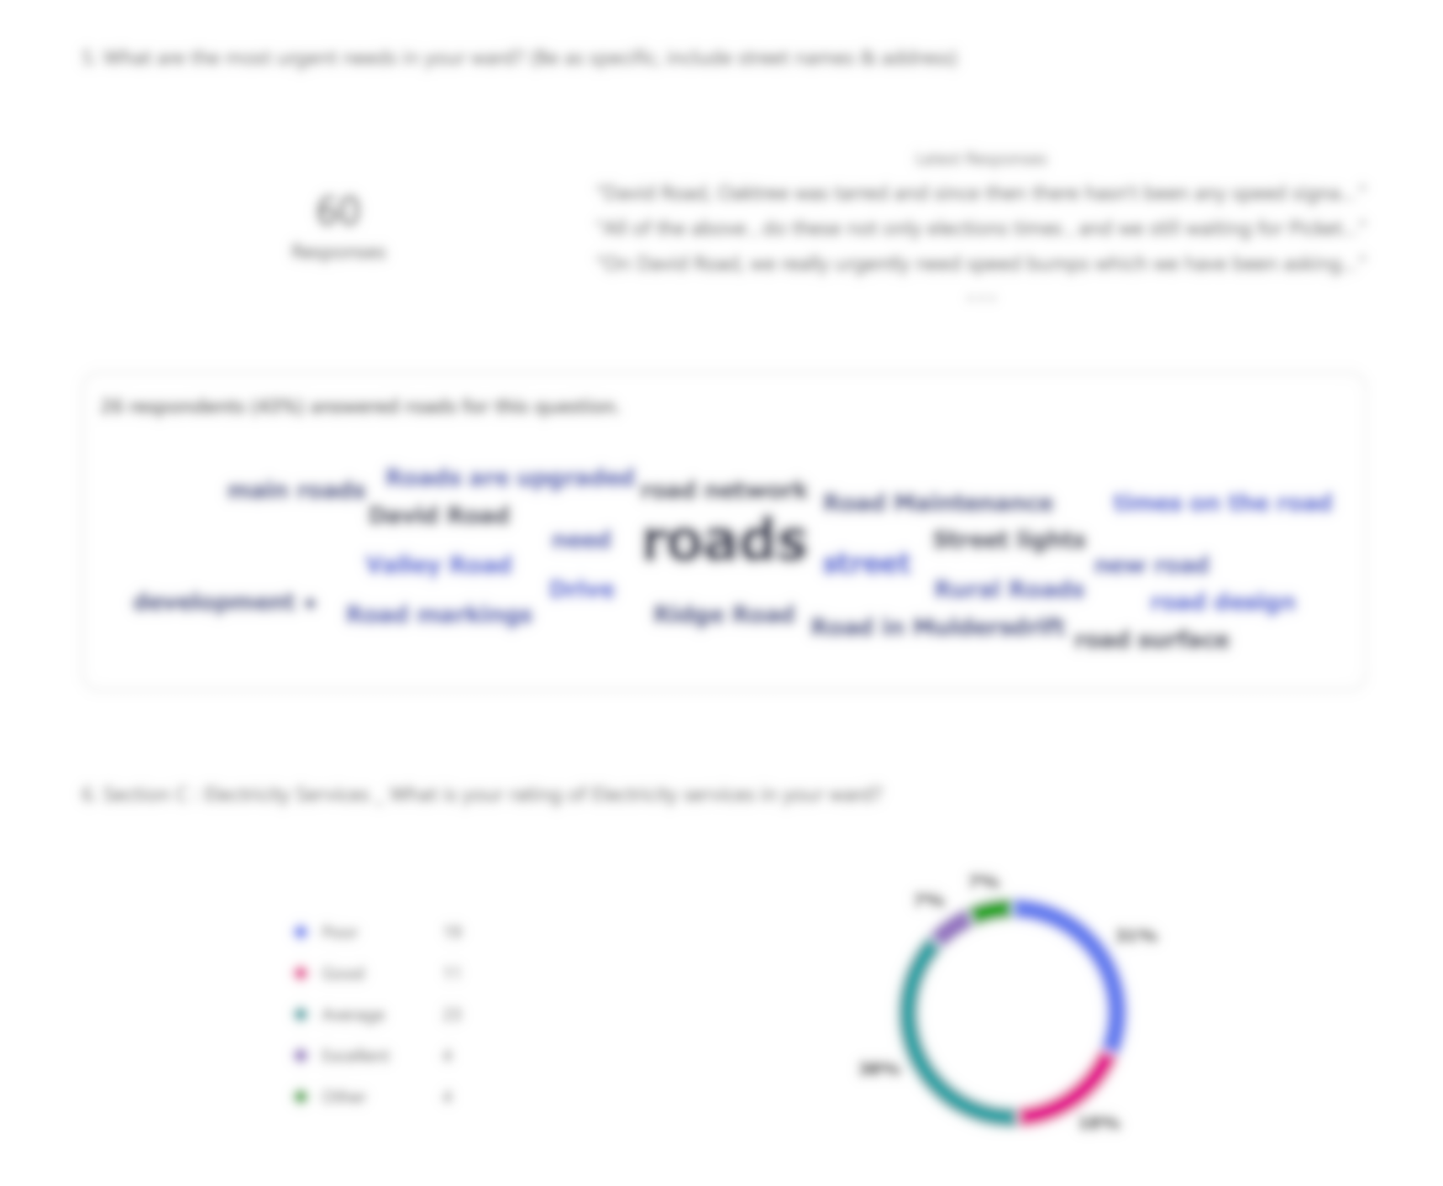
Pilot Phase 1: Enhance Outreach | 2025-2026
Use off-the-shelf tools to improve information sharing, expand engagement online and organise data for action and response
Website or Canva flyers with link/ QR code to dashboard
Flourish dashboard for ward profiles, capital projects
Microsoft Form for submitting comments and rate satisfaction
Spreadsheet output for analysis, action and feedback

Slide 5
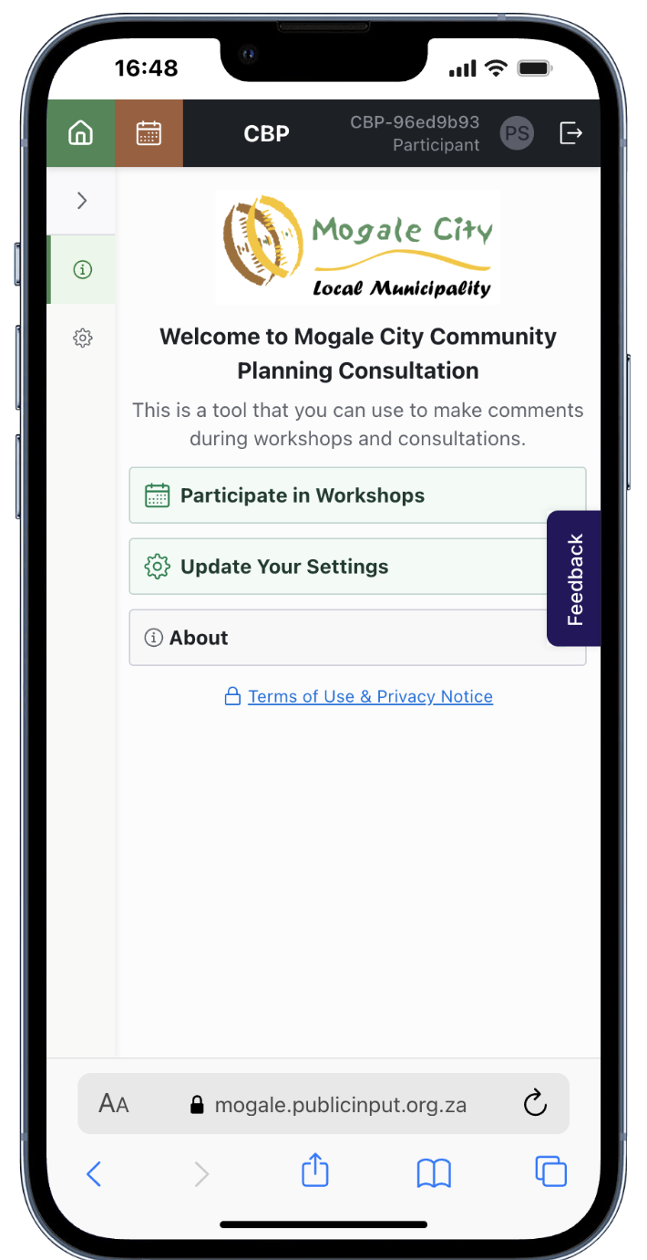
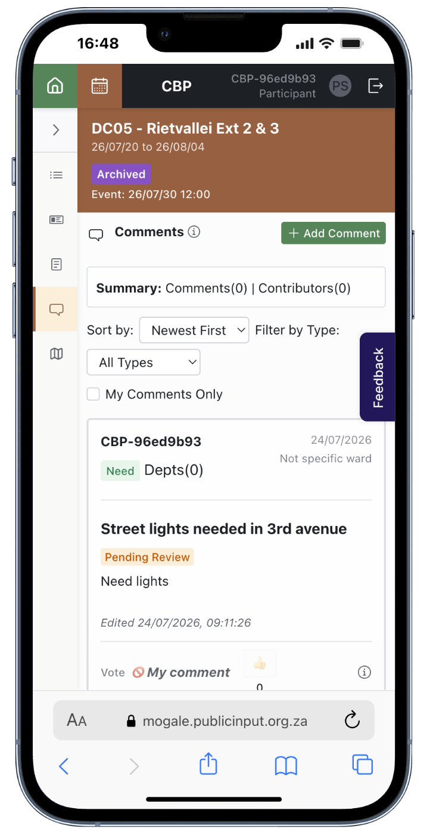
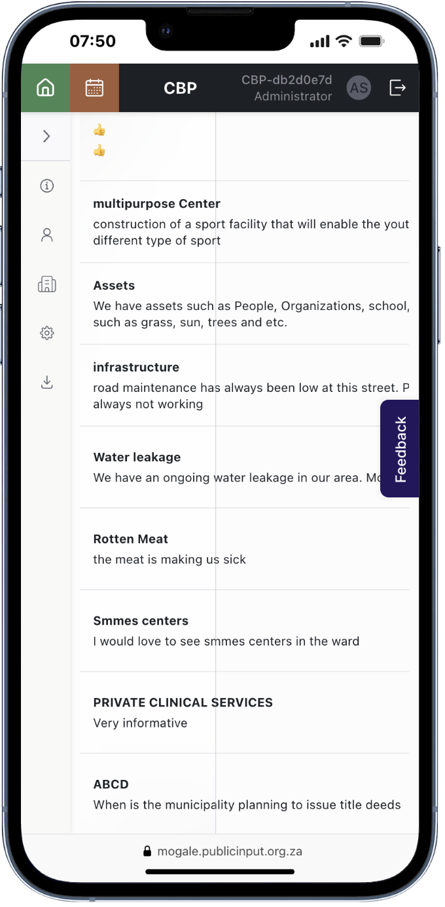
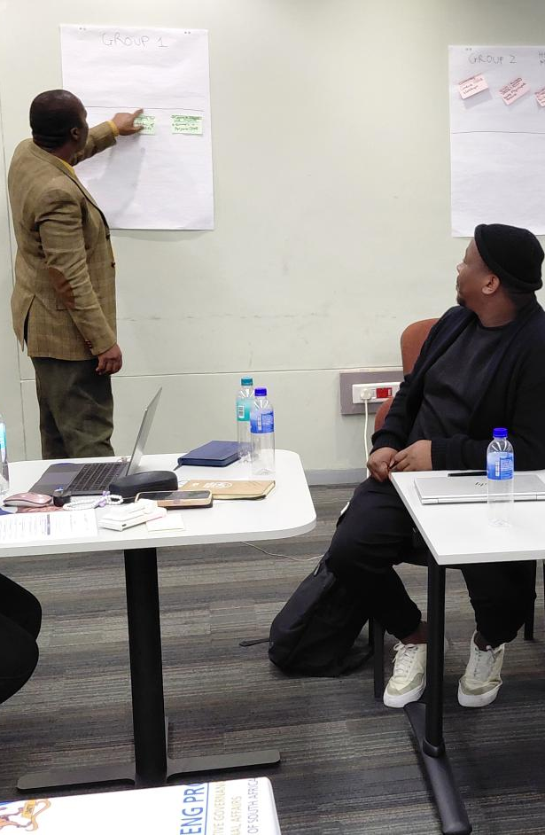
Pilot Phase 2: Test Custom Tool for ABCD | 2026 on
Custom tool to be tested in Asset-Based Community Development (ABCD)-enabled workshops and roadshows. Includes transparent recording of inputs, community interaction (read, like, comment), structured data outputs for discussion
Website or Canva flyers with link/ QR code to dashboard
CBP Digital Tool to view documents and presentations, capture, submit and view comments (needs/ assets)
Review comments and discuss issues and assets, identify projects for joint action

Slide 6
Outcomes and institutionalisation
BENEFITS
CHALLENGES
INSTITUTIONALISATION
Increased Community Engagement
Delays Users reported
Policy Framework: e-participation policy aligned to MSA and IDP guidelines
Cybersecurity and Privacy Concerns
Resources: budget for digital tools, trained staff
Improved Accessibility & Inclusivity
Cost-Effective Public Participation
Limited Internet Access
Capacity Building: councillors, ward committees, officials and residents
Digital Literacy Gaps
Executive & Political Support: regular reporting to Council on progress, political champions to advocate for tool use
Real-Time Feedback and Data Collection
Phase 1 not Interactive or Supporting Feedback
Phase 2 Transparency and Interaction
Integration: strengthen link from (e-)participation to IDP/Budget processes

Slide 7
Way forward
Short-term priorities
Strategic priorities
Strengthen awareness campaigns in low-participation wards
Expand assisted digital participation points
Address citizen feedback gaps
Monitor participation through a dashboard
Test integration of digital tool with ABCD workshops
Implement the August 2026 DSTI–Mogale City MoU
Scale the programme across all wards
Institutionalise e-participation within IDP and service-delivery processes
Strengthen partnerships with HSRC, DSTI and stakeholders
Conclusion: e-Participation is moving from a pilot initiative to a practical, institutional mechanism for stronger public engagement

Slide 8
Thank you

