Slide 1


DIGITAL HUMANITIES AND ARTIFICIAL INTELLIGENCE IN AFRICA
Opportunities, Tensions, and the Imperative for Indigenous Knowledge Governance
Ayo Ojebode
September 2026
Notes:
Left this here but don't think you need it. So hidden it.

Slide 2
Guidance
Font size: 24pt.
As a general guide, allow approximatley one slide per minute.
Use no more than five bullet points per slide.
Keep the text concise and use images where these communicate the message more effectively.

Slide 3
Did we just start a fire?
Did we just start a fire or are we being alarmists again?
The big news this week…

Slide 4
Digital Humanities … and AI
DH is an evolving field: Digital Ethnography, Digital History, Digital Heritage, Digital Linguistics, Spatial Humanities, Critical DH, AI Humanities...
Now about doing Humanities in a digital and AI-shaped world: prompting the question of what happens when machines become an actor in how we know ourselves.
At the initial level, it is about doing Humanities digitally using digital tools
Notes:
Massive digitization of archives – Timbuktu archives of over 40k books and documents; Ifa’s basic 260 chapters of corpa, africanarchives.com etc.

Slide 5
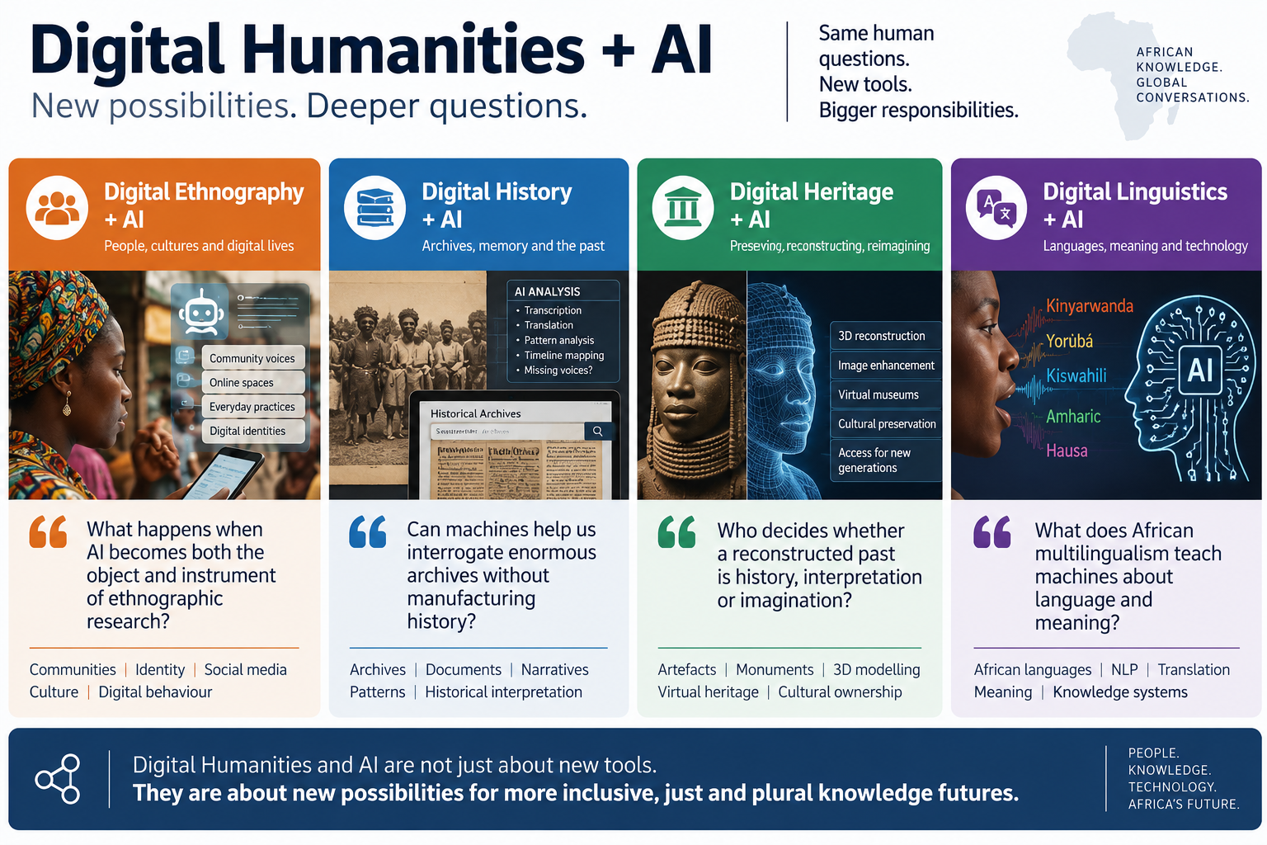
DH and AI: new possibilities

Slide 6
The opportunity
01
Read vast archives
02
Analyse texts, images and sounds
03
Transcribe and translate
04
Discover connections and patterns
05
Make knowledge more accessible
06
Create new ways of teaching and engaging
Notes:
AI expands what Digital Humanities can do
The archive can become more than a repository.

Slide 7
Tension 1: Digitizing vs knowing
But knowledge also carries context, relationships, memory, meaning, authority
Context is not information around knowledge; context is part of knowledge.
“She is my husband”.
What gets lost between the record and the meaning?
A digital record can preserve words, Images, Sounds, Stories.
Notes:
Mato Oput – drive through healing …
Mi o ki n se egbe re ….

Slide 8

Tension 2: Supporting vs supplanting
AI can search, translate, summarise, analyse, interpret, generate
The distance an elder can see sitting down, a young person cannot see standing up ... even with Google Earth.
But fluency is not truth, and efficiency is not understanding.
What happens when AI takes the place of the elder?
Notes:
The distance an elder can see sitting down, a young person cannot see standing up ... even with Google Earth.

Slide 9
Tensions …
Flying the helicopter vs walking the streets
Building mortuaries vs building clinics
Notes:
[Math in Philosophy – God and the real number] …

Slide 10
Rejecting the Deficiency Posture
AI can give us answers but the Humanities can teach us to question them.
The Humanities bring history, context, interpretation, ethics, meaning and memory.
One is not inferior to or at the mercy of the other …
No other time calls for multi- and transdisciplinary collabo than now
Notes:
[Math in Philosophy – God and the real number] …

Slide 11
Indigenous Knowledge Systems
Those unique, “local”, and traditional knowledge that African communities have developed over thousands of years to survive and thrive in their environments …
The demotion, partial loss and … the renaissance … with AI (AIKRN, AFRIAK etc)
Notes:
Dogon architecture; the rainmakers of East Africa and Eastern Nigeria, Sahelian Agriculture, Yoruba Ifa episteme and oral library … Nsibidi Southern Nigeria writing systems, old Benin metal work skills, the Acholi traditional post-conflict healing systems,

Slide 12
The imperative: Indigenous Knowledge Governance
Document
Digitise
Who governs this journey?
Ownership
Control
Access
Possession
What happens after digitisation?
Store
Access
Analyse
Train AI
Generate
Notes:
This slide was repeated in your original slides

Slide 13
Renaissance or recapture
More than 40 African countries have passed data control policies and laws … but … infrastructure gap, power shortages and server concentrations …
Only 20% of African digital data are stored in Africa. Europe, North America and parts of Asia

Slide 14
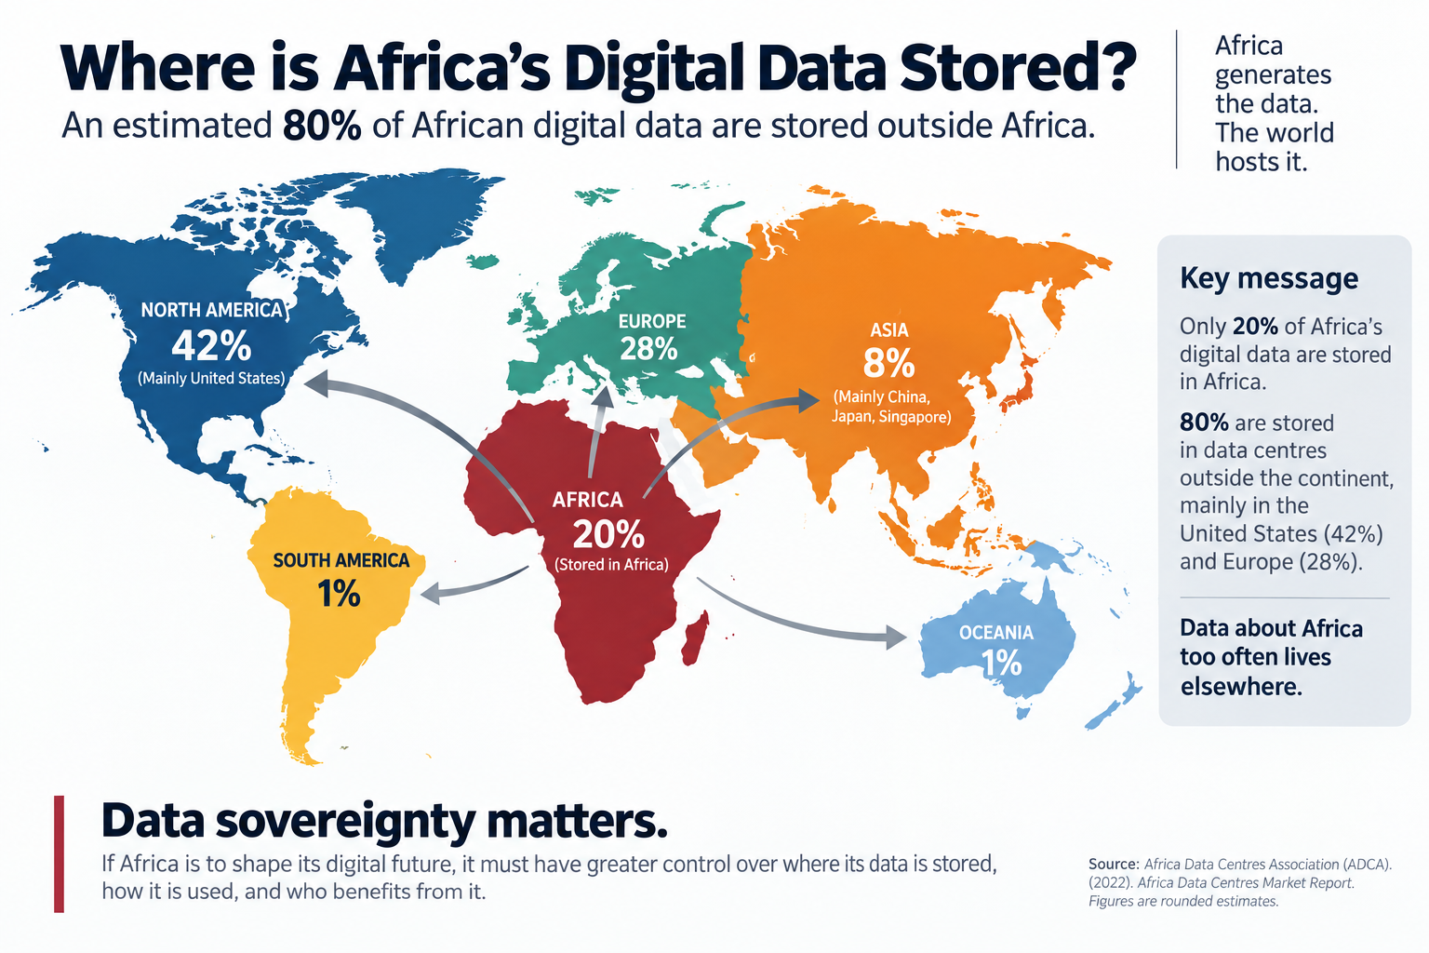

Slide 15
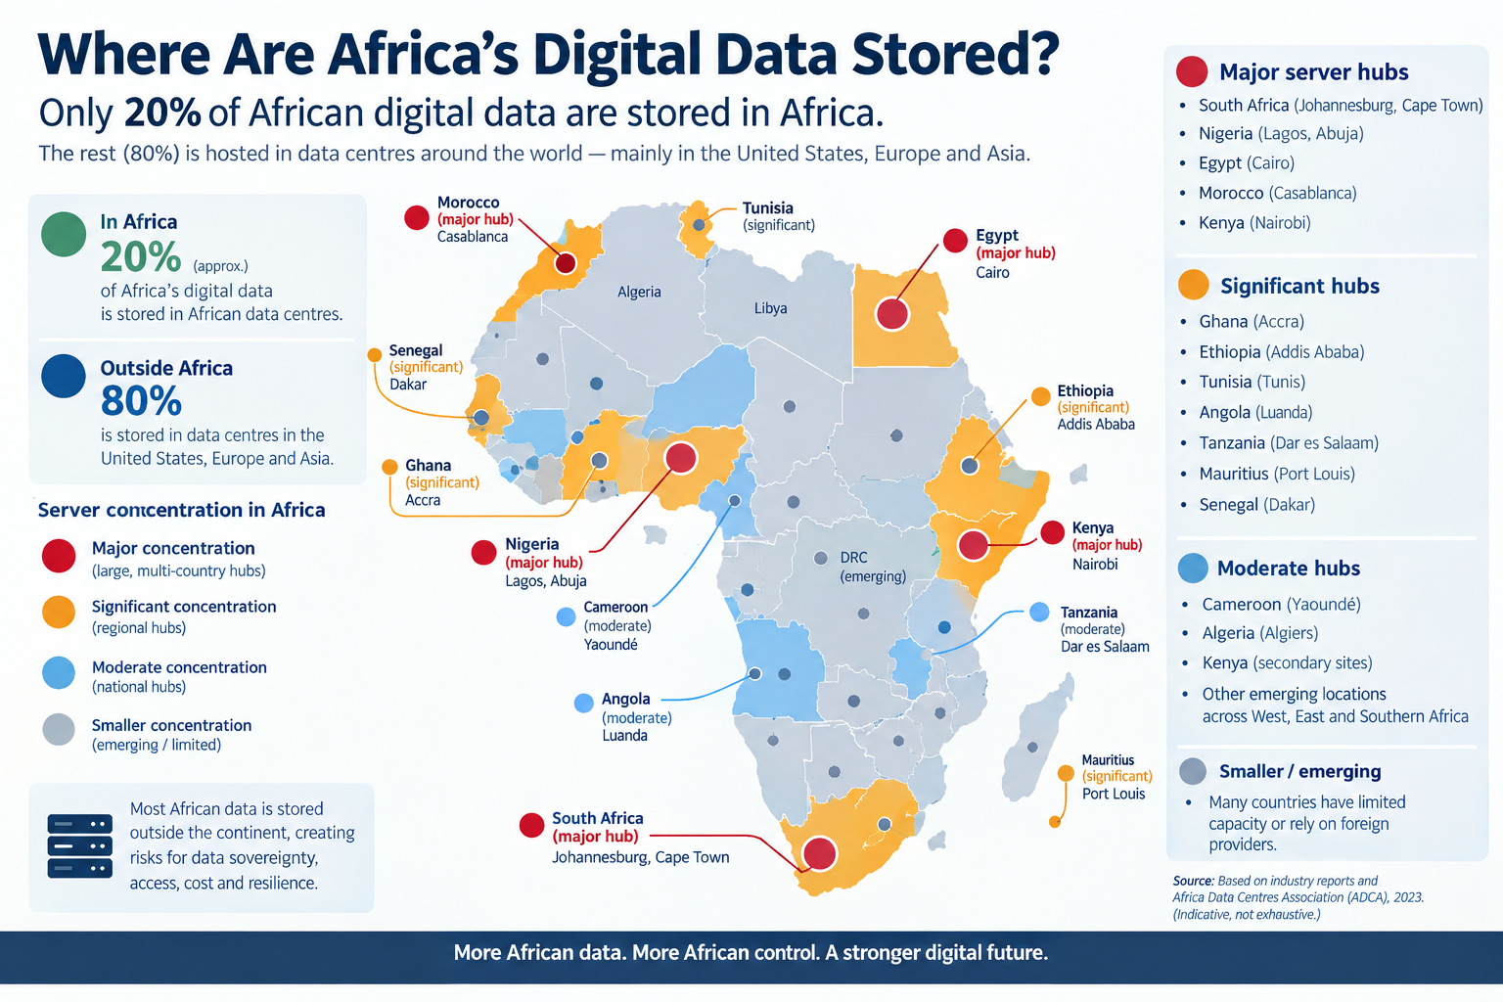
Where is our data stored?

Slide 16
A new African Digital Humanities agenda
Three movements
Why not an African framework for Indigenous Knowledge + Digital Humanities + AI
From archive to living knowledge
From using AI to shaping AI
From access to governance

Slide 17
Thank you

