Slide 1


The Future Scenarios of Writing (with AI)
Presented by: Prof. Petrus Letaba
Date: 16 September 2026

Slide 2
Introduction
The foundational act of writing is facing an unprecedented challenge from GenAI, which is moving beyond simple automation to actively participate in creative and scholarly processes.
This shift is the latest in a series of technological revolutions that have redefined writing:
  Oral Age
  Chirographic (Manuscript) Age
  Print Age
  Digital Age
Objective: Moving beyond the hype and polarised narratives to provide a foresight-grounded analysis of the future scenarios for machine writing.

Slide 3
Methodology
Identification of key drivers from select academic literature (PESTLE framework)
Organise PESTLE factors into barriers, drivers and opportunities (future triangle)
Prioritise five factors using a relevance matrix (impact and probability)
  Disruptive (H/H); Emerging (L/H); Wild Card (H;L) Weak Signal (L/L)
Causal Layered Analysis: Litany; Systemic View; Worldview; Metaphor overarching metaphor
Scenarios development: 2 x 2 matrix (control and certainty)

Slide 4
Macro Factors [1]
 | Contribution to the Future of Machine Writing | Sources
Political | Positive: Polycentric governance emerging; Pro-innovation policies; institutional adaptation; accessibility and democratisation; responsible innovation frameworks Negative: Big Tech power consolidation/ regulatory capture, narrow risk-focused governance/ over-regulation; restrictive AI authorship bans | Ammore et al. (2025); Durrani et al. (2025); Hosseini et al. (2025); Khanal et al. (2025); Ulnicane (2025)
Economical | Positive: Massive productivity gains; new jobs creation; cost reduction across functions; disruptive business models; levelling playing field (non-native English speakers); accelerated innovation; demographic offset in developed countries Negative: Massive Jobs displacement; wages compression; content devaluation; monopolies; investment barriers; high energy cost; middle class contraction | Iorga (2022); Ochard & Tasiemski (2023); Islam et al. (2026); Chui et al. (2023); Occhipinti et al. (2025)
Social | Positive: Increased accessibility; cognitive extension; democratisation/ social participation; human agency through design; support for non-native speakers; collaborative human-AI writing; real-time personalised feedback; educational inclusivity Negative: Erosion of human writing skills; loss of authentic voice; homogenisation; new social divide/digital inequality; misinformation and fake content; academic integrity erosion; disembodied interaction risks; biased content propagation; surveillance and privacy concerns | Cunha (2025); Sabherwal (2024); Al-Emran et al. (2024); Liu et al. (2025); Ursavas et al. (2025)

Slide 5
Macro Factors [2]
 | Contribution to the Future of Machine Writing | Sources
Technological | Positive: Improved language and writing mechanics; human-AI symbiosis; advanced summarisation and explanation of existing knowledge; support for idea generation and creativity; automation of mundane tasks; versatility in style and tone adjustment; potential for personalised writing assistance Negative: Hallucinations; bias and misinformation; inability to think critically or generate true novelty; lack of transparency and explainability | Durrani et al. (2025); Lee et al. (2024); Bishop (2023); Godwin-Jones (2022); Tufail et al. (2023)
Legal | Positive: Emerging copyright clarity; clearer definitions and value chain allocation; expansion of content moderation laws; use of technology-neutral laws Negative: Lawsuits; plagiarism liability; regulatory lag; unintended consequences of regulation; risk of misinformation and malicious content | Ungureanu & Amironesei (2023); Sharma & Sharma (2024); Hacker et al. (2023); Wang & Wu (2024); Novelli et al. (2024)
Environmental | Positive: Potential for energy efficiency improvements; marginal per-unit efficiency; use of task-specific and smaller models; AI for materials discovery Negative: 5–19× higher CO₂ than humans; growing energy demand; resource depletion (abiotic depletion); electronic waste; substantial water consumption | Berthelot et al. (2025); Radovan et al. (2026); Kan (2025); Woo (2025); Bashir et al. (2024)

Slide 6
Future Triangle (AI adoption momentum)
Drivers | Opportunities | Barriers
Governance and institutional drivers Legal and regulatory clarity Economic growth and productivity Democratisation and inclusion Human-AI collaboration and cognitive enhancement Technological capabilities Environmental efficiency | Responsible and participatory governance Economic transformation and reskilling Preserving human voice and agency Smart legal frameworks Sustainable AI models | Power concentration and governance failures Economic and labour disruption Social and cultural erosion Information integrity and trust Technical limitations Legal uncertainty and regulatory lag Environmental unsustainability

Slide 7
Causal Layered Analysis of Key Trends
 | Litany | Systemic Causes | Worldview | Metaphor
Human-AI collaboration and skills | "Students can't write anymore. AI writes better than us." | LLMs make fluent text near-free; education rewards output over process; economic pressure to adopt AI. | Writing as product vs. process; skills static vs. co-evolve with tools. | Prosthetic Limb – AI restores or atrophies writing muscle depending on use.
Economic disruption (jobs/ costs) | "Million jobs lost. Content is worthless. The middle class is shrinking." | Marginal cost of text → zero; AI models flooded; labour markets slow; capital concentrates in computing-owners. | Scarcity vs. abundance drives value; technology destroys vs. transforms. | Printing Press 2.0 – Text is cheap; new roles emerge from the flood.
Information integrity | "AI lies. You can't trust anything. Deepfakes end democracy." | LLMs pattern-match, not fact-check; training data contains biases; no accountability; speed beats verification. | Truth objective vs. constructed; trust institutional vs. personal; more info vs. more noise. | Hall of Mirrors – AI reflects human text vs. distorted; signal vs. echo indistinguishable
Governance and legal frameworks | "AI is unregulated. Big Tech owns the future. Copyright is broken." | Law moves slower than code; nations compete; regulators lack expertise; incumbent lobbying; liability unclear. | Regulation enables vs. stifles; markets self-correct vs. fail; AI as tool vs. actor. | Wild West Frontier – New territory, no sheriffs; claims staked by the fastest horse (computing).
Environmental footprint | "One model = 5 cars' lifetime emissions. AI dries up water." | Scaling demands exponential computing; data centers near cheap energy/water; hardware turnover; no carbon pricing. | Tech progress justifies cost vs. limits non-negotiable; efficiency saves vs. enables more scale. | Gilded Data Centre – Beautiful outside (AI magic), devastating inside (resource theft).

Slide 8
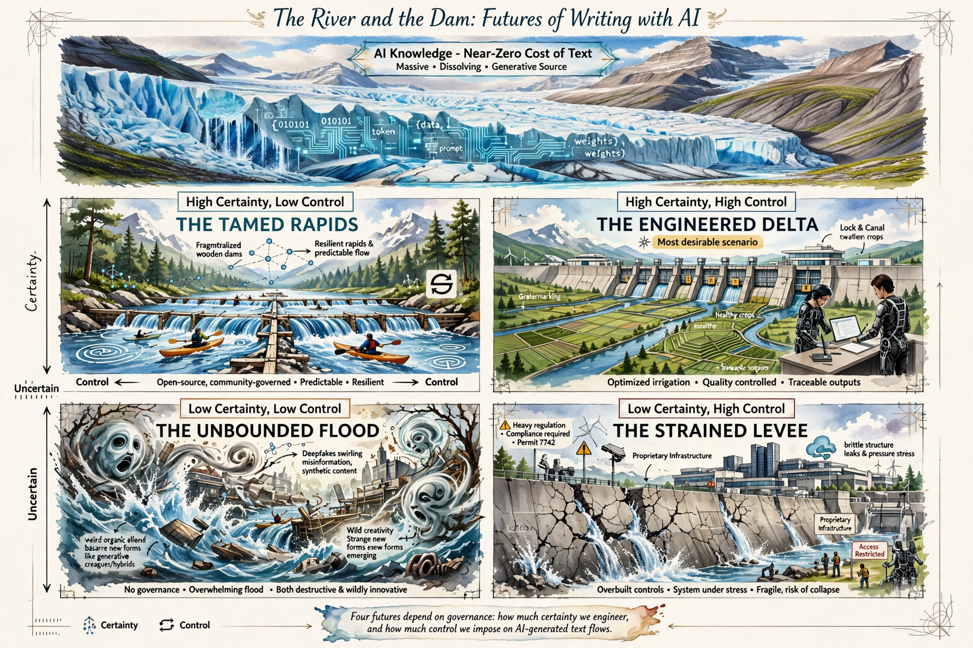
Scenarios of AI-Assisted Writing

Slide 9
Scenario Narratives
Certain | THE TAMED RAPIDS Governance is minimal or fragmented. No single authority controls machine writing. Open-source models proliferate; anyone can run a frontier model on their laptop. There is no copyright clarity – but the market self-organises around attribution and reputation. Big Tech competes with open-source, but no one has monopoly power. Jobs are disrupted predictably – we know which roles will vanish and which will emerge; labour markets adjust organically (though painfully). Education adapts late but eventually embraces AI as a fact of life. Truth is managed through decentralised reputation systems (e.g., community notes, and blockchain provenance). Environmental costs are high but predictable – we know the trajectory and invest in offsetting. The system is resilient because no single point of failure exists. | THE ENGINEERED DELTA Governance catches up with technology. Clear, technology-neutral laws emerge. Copyright is redefined for human-AI co-authorship. Education systems systematically integrate AI as a writing exoskeleton while preserving critical thinking through rigorous process-based assessment. Big Tech is regulated as a public utility; open-source models thrive under transparent standards. Environmental costs are priced in – carbon and water taxes fund green computing and small-model innovation. The middle class stabilises through massive reskilling programs. Truth is restored through cryptographic watermarking and third-party fact-checking APIs.
Uncertain | THE UNBOUNDED FLOOD Everything is in flux. AI capabilities leap unpredictably – emergent reasoning, self-improvement, synthetic data explosions. No governance framework exists; treaties fail. Open-source and closed-source models proliferate chaotically. Truth is dead – deepfakes and hallucinations are indistinguishable from reality. Writing skills collapse globally; authentic human voice becomes a luxury good. Jobs vanish faster than anyone can measure; new jobs appear and disappear in months. Big Tech and open-source coexist in a hyper-competitive, zero-trust environment. Environmental costs are catastrophic – energy demand skyrockets, water is drained, e-waste mountains grow. But also: radical creativity emerges. New literary forms, new languages, new ways of thinking are born from human-AI co-creation. The future is terrifying and exhilarating – but entirely unpredictable. | THE STRAINED LEVEE Regulation is heavy, prescriptive, and risk-averse (EU-style AI Act on steroids). AI authorship is heavily restricted or banned in many contexts. Copyright lawsuits multiply; liability fears freeze innovation. Big Tech consolidates further because only they can afford compliance costs – regulatory capture is complete. Meanwhile, the technology evolves unpredictably: sudden leaps in reasoning, emergent agency, or synthetic data loops cause cascading failures. Hallucinations become harder to detect as models grow more fluent. Energy demand spikes unpredictably with each new model release. The system is brittle – one major AI-facilitated disinformation event or grid failure triggers a crisis. Regulators react slowly, always behind the curve. The public loses trust in both AI and institutions.
 | Lack of Control | Control

Slide 10
Strategic Implications
Action | Delta Scenario | Levee Scenario | Rapids Scenario | Flood Scenario
Invest in human critical thinking education | x | x | x | x
Support green AI / small-model R&D | x | x | x | x
Advocate for technology-neutral laws | x | x | x
Build portable, cross-sector reskilling systems | x | x | x
Develop cryptographic provenance/watermarking | x | x | x
Push for polycentric international AI treaty | x
Rely on market self-correction |  |  | x

Slide 11
Scenario-Specific Indicators
Indicator | Points Toward
Major international AI treaty signed | Delta
EU AI Act expanded with heavy compliance costs | Levee
Open-source model matches closed-source performance with 10× less computation | Rapids or Flood
Landmark lawsuit finds AI company liable for hallucinations | Levee
Mass literacy decline detected in OECD PISA scores | Levee, Rapids or Flood
A major deepfake triggers a geopolitical crisis | Flood
Green computing mandate passed in G7 | Delta
Big Tech acquires all major open-source labs | Levee
A new model exhibits unexpected reasoning without scaling | Flood

Slide 12
Conclusion
Beyond polarised narratives: the future of writing is neither predetermined nor monolithic, but shaped by worldviews, systems, and strategic choices
Five interconnected themes: human-AI collaboration, economic disruption, information integrity, governance, and environmental footprint
No-regret actions: critical thinking education, green AI & small-model R&D, and technology-neutral laws
Bottom line: Writing won't end, it will be reimagined.
  The writer shifts from text-producer to strategic rhetorical agent.
  The critical task: cultivating critical AI literacy to preserve human agency, authenticity, and writing's democratic value

Slide 13


Changing Knowledge Repository

Slide 14
Thank you

